Slide 1
SQL Day 3

Slide 2
Day | Topic | Chapter Details | Time Duration
Day 3 | Sorting | Sorting results | 60 mins
 |  | Sorting text
 |  | Sorting single fields
 |  | Sorting multiple fields
 |  | Grouping data
 |  | GROUP BY single fields
 |  | GROUP BY multiple fields
 |  | Filtering grouped data
 |  | Filter with HAVING
 |  | HAVING and sorting
 | 5 mins Break
 | Joins Part I | The ins and outs of INNER JOIN | 60 mins
 |  | Your first join
 |  | Joining with aliased tables
 |  | Defining relationships
 |  | Relationships in our database
 |  | Inspecting a relationship
 |  | Multiple joins
 |  | Joining multiple tables
 |  | Checking multi-table joins

Slide 3

Revision
Case Study 1:
Retrieve the details of the top 5 highest-paid employees who work in the 'Sales' department, ordered by their salary in descending order.

Slide 4
Solution
SELECT TOP 5 *
FROM Employees1
WHERE department = 'Sales'
ORDER BY salary DESC;

Slide 5
Revision
Case Study 2:
Retrieve the employee details for employees working in the 'IT' department who have more than 7 years of experience. Display the results in descending order based on their hire date.

Slide 6
Solution
SELECT *
FROM Employees
WHERE department = 'IT' AND years_of_exp > 5
ORDER BY hire_date DESC;

Slide 7


Slide 8
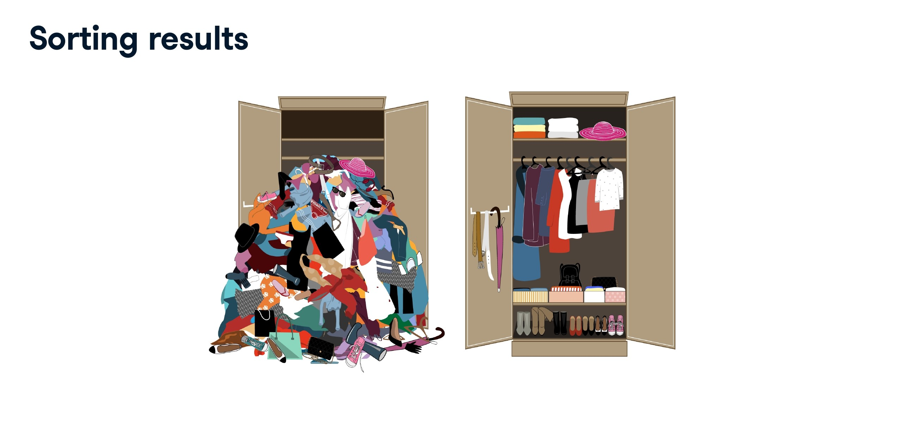

Slide 9
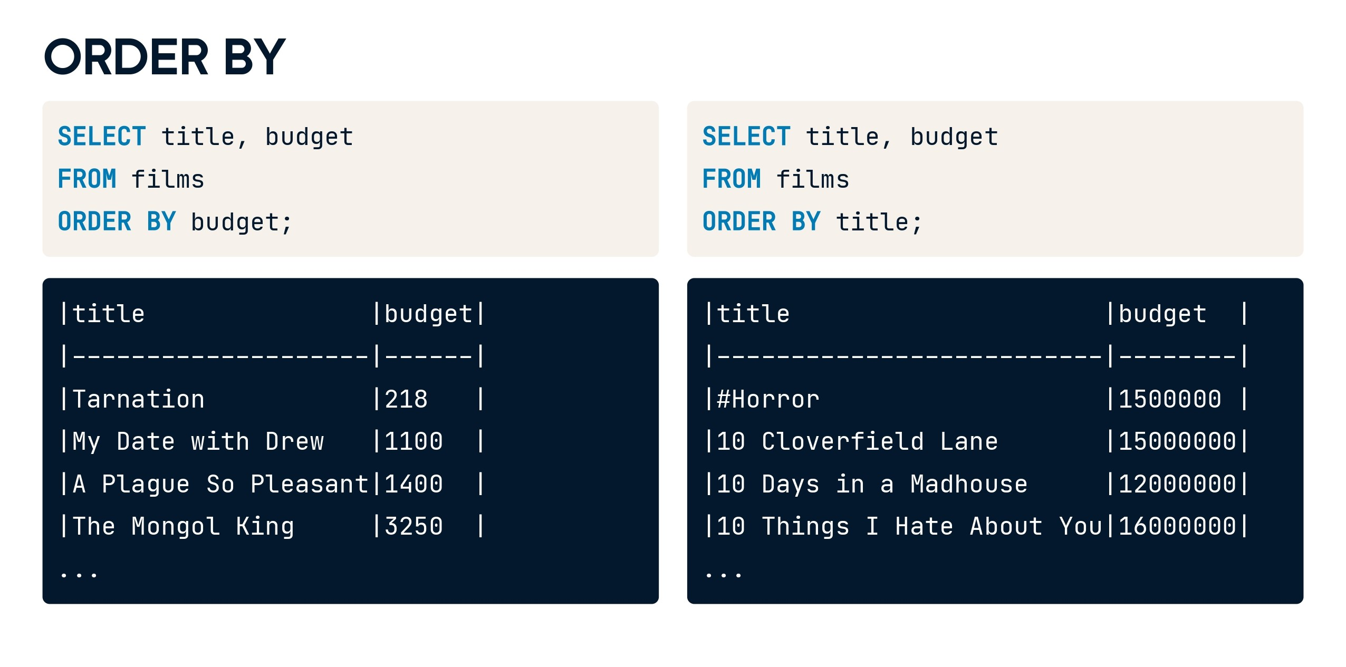

Slide 10
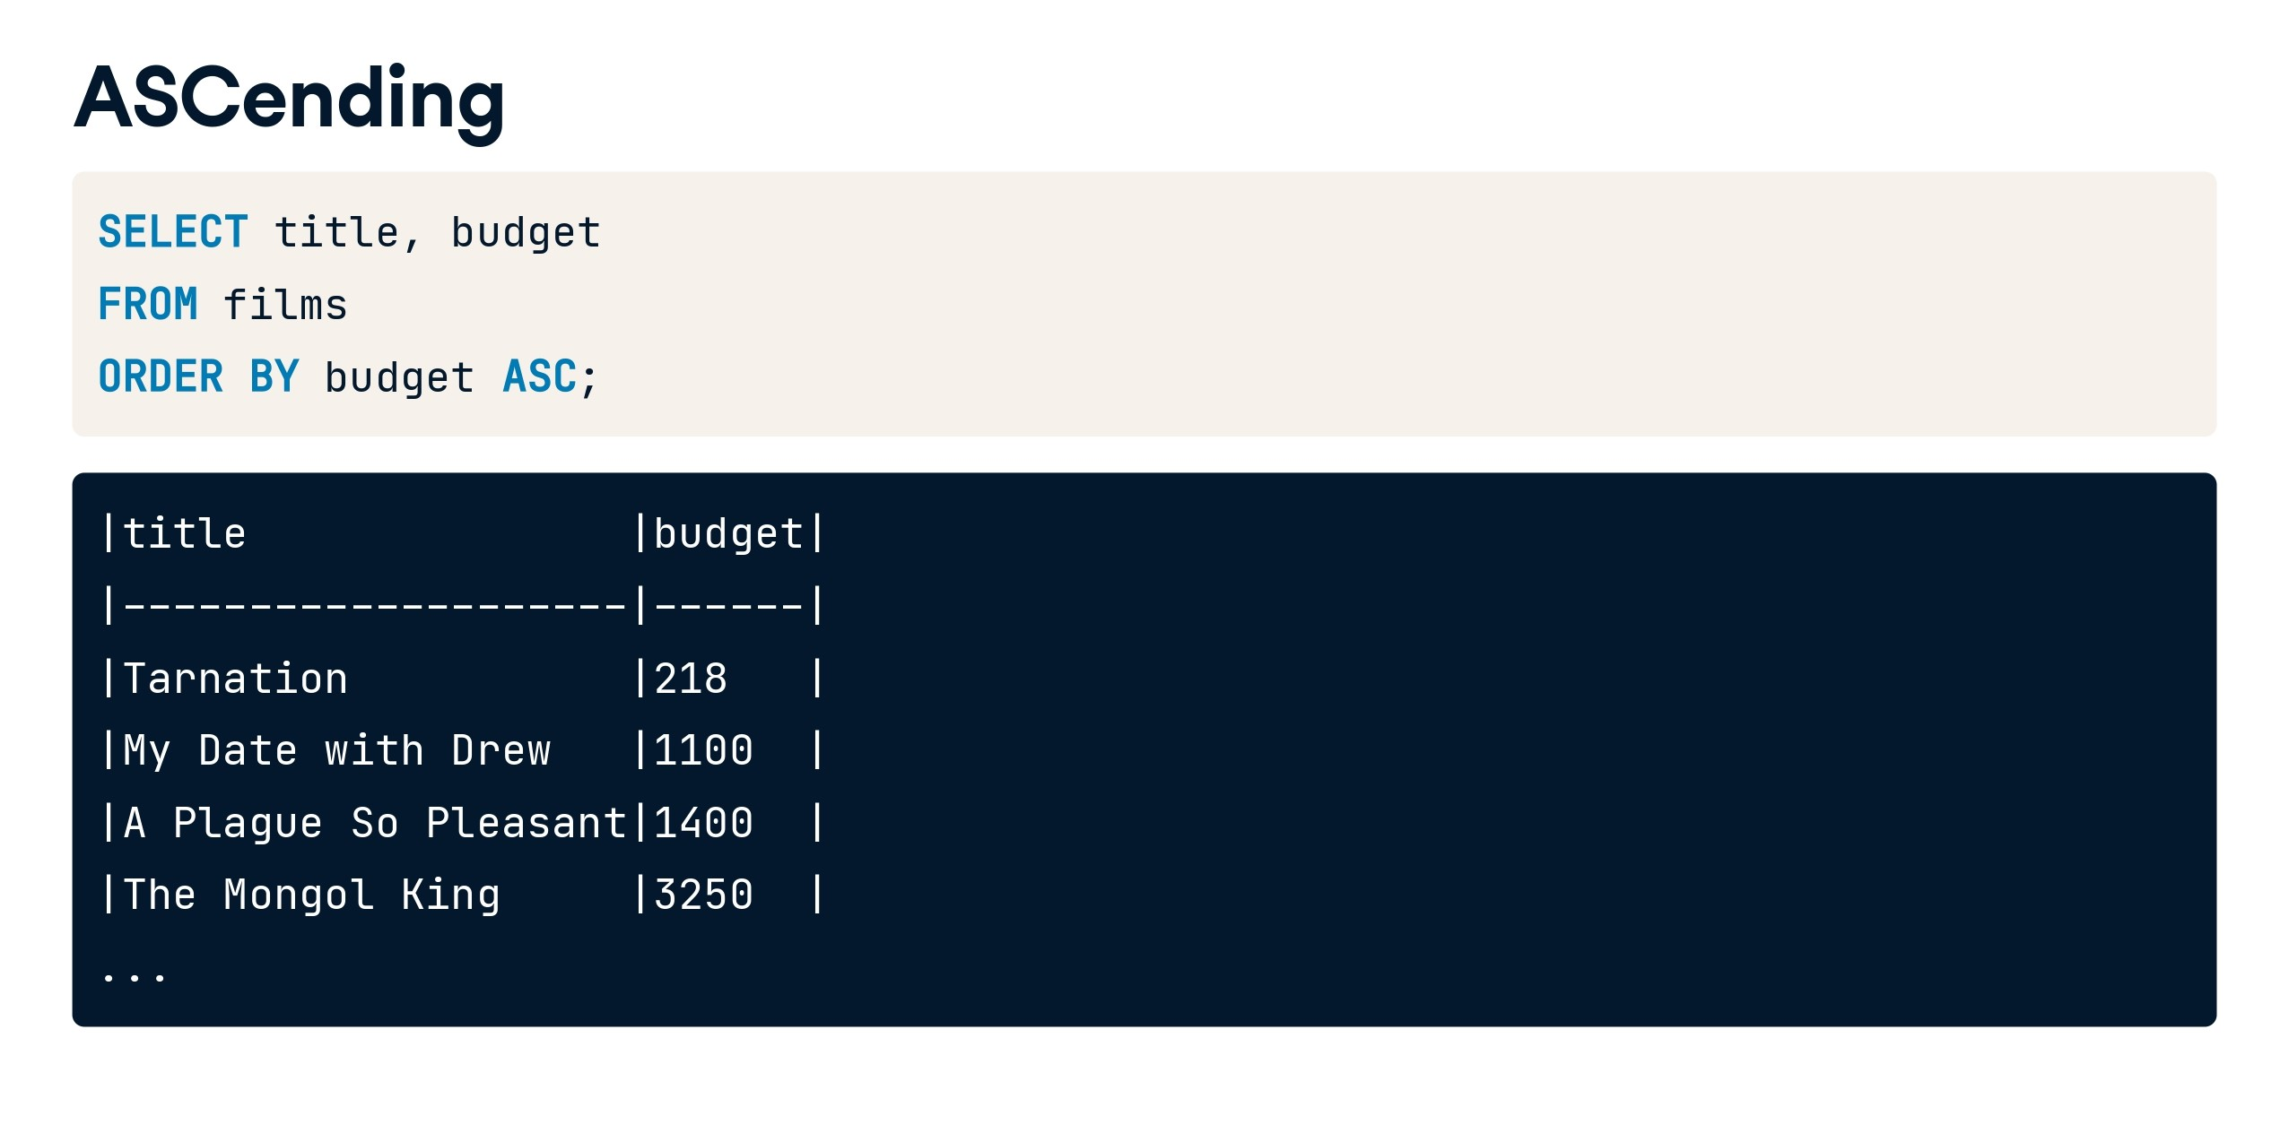

Slide 11
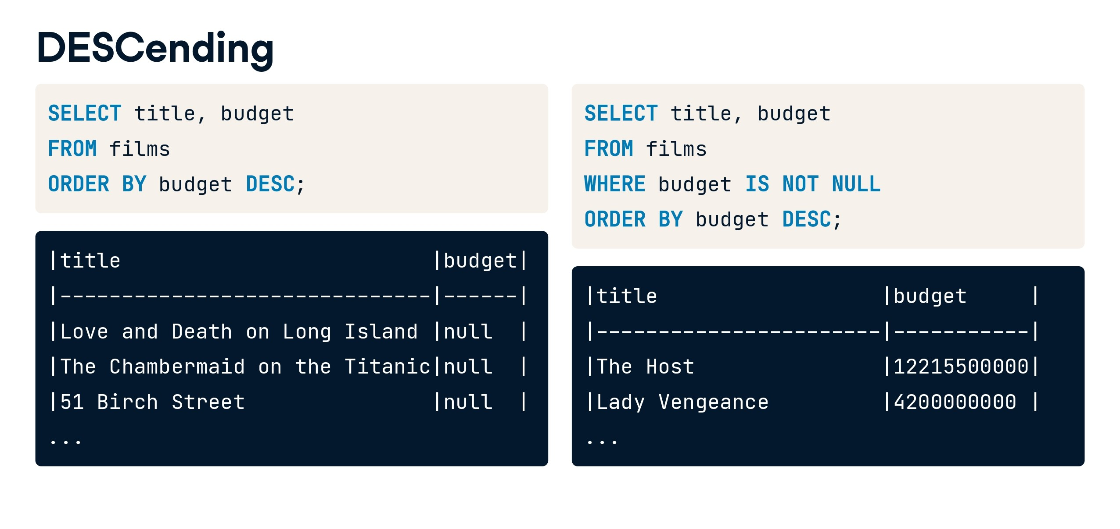

Slide 12
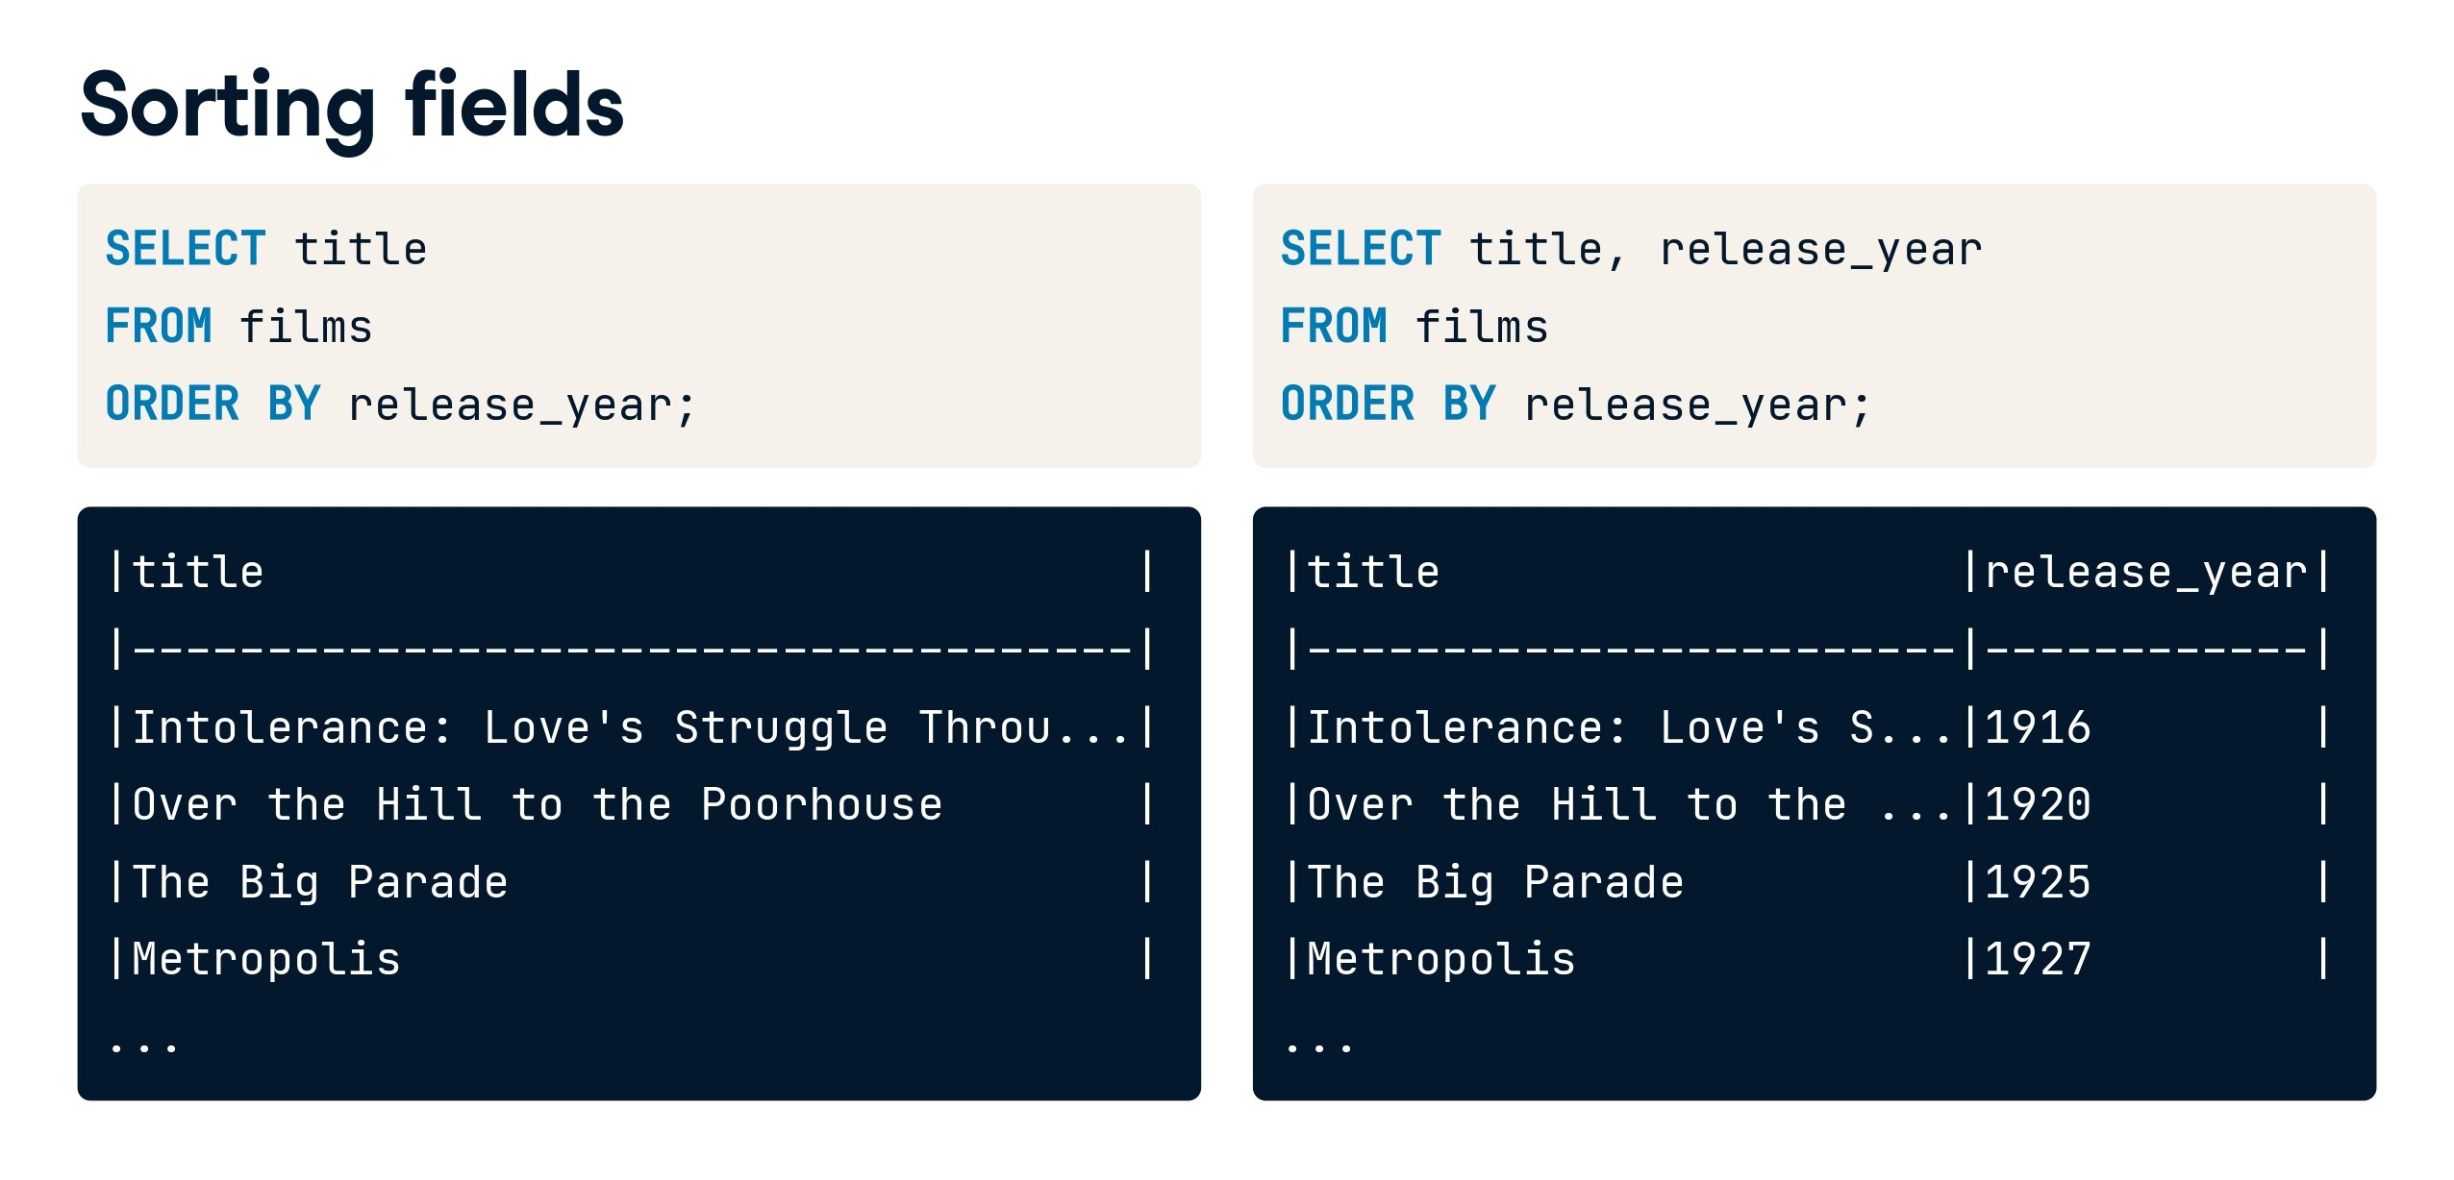

Slide 13
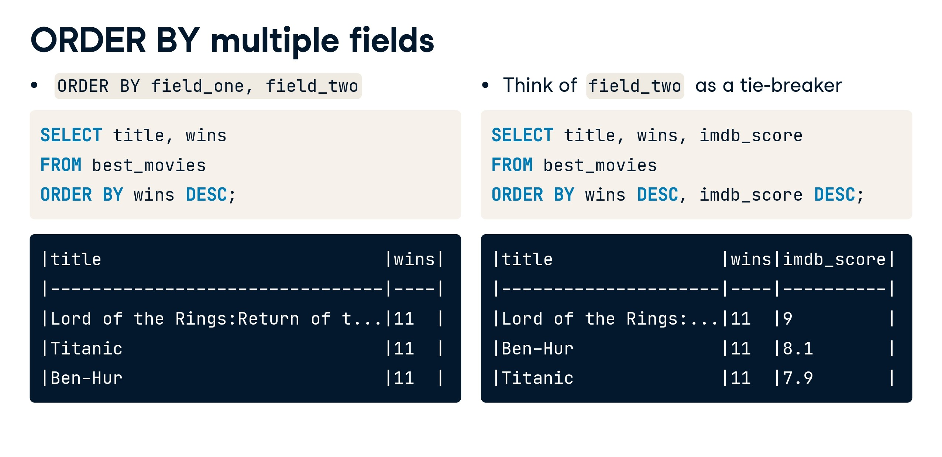

Slide 14
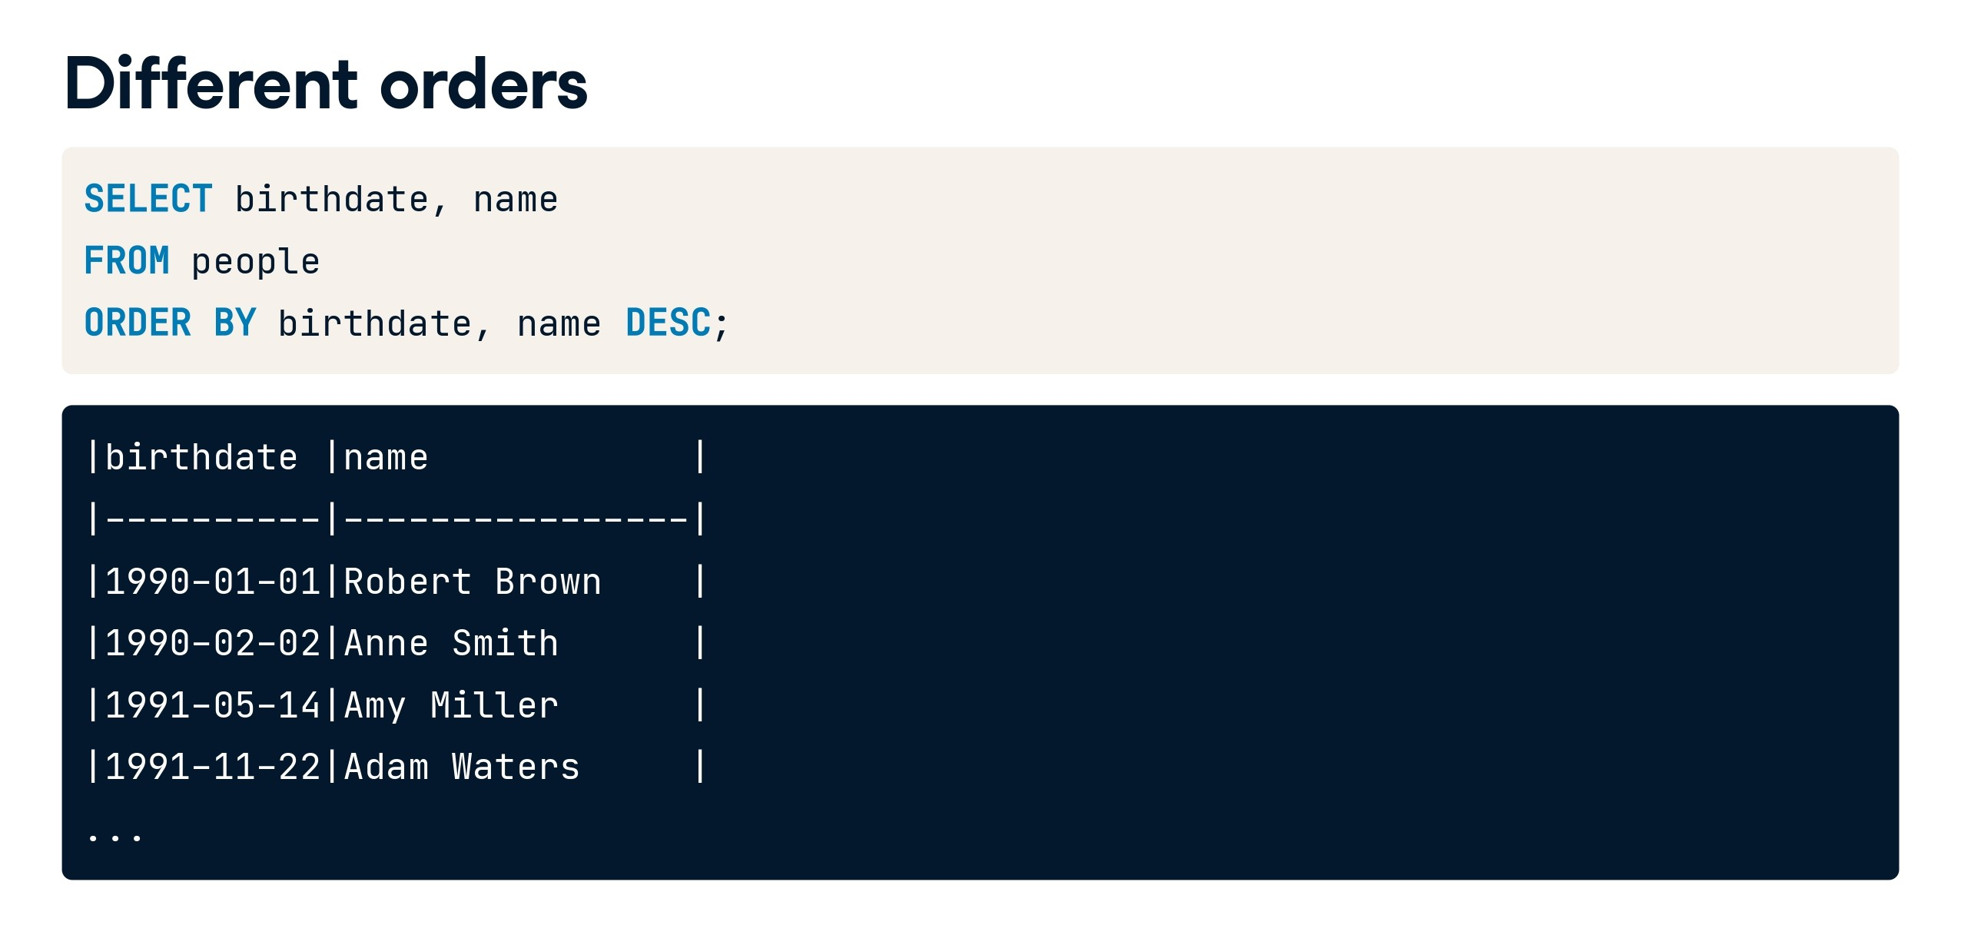

Slide 15


Slide 16
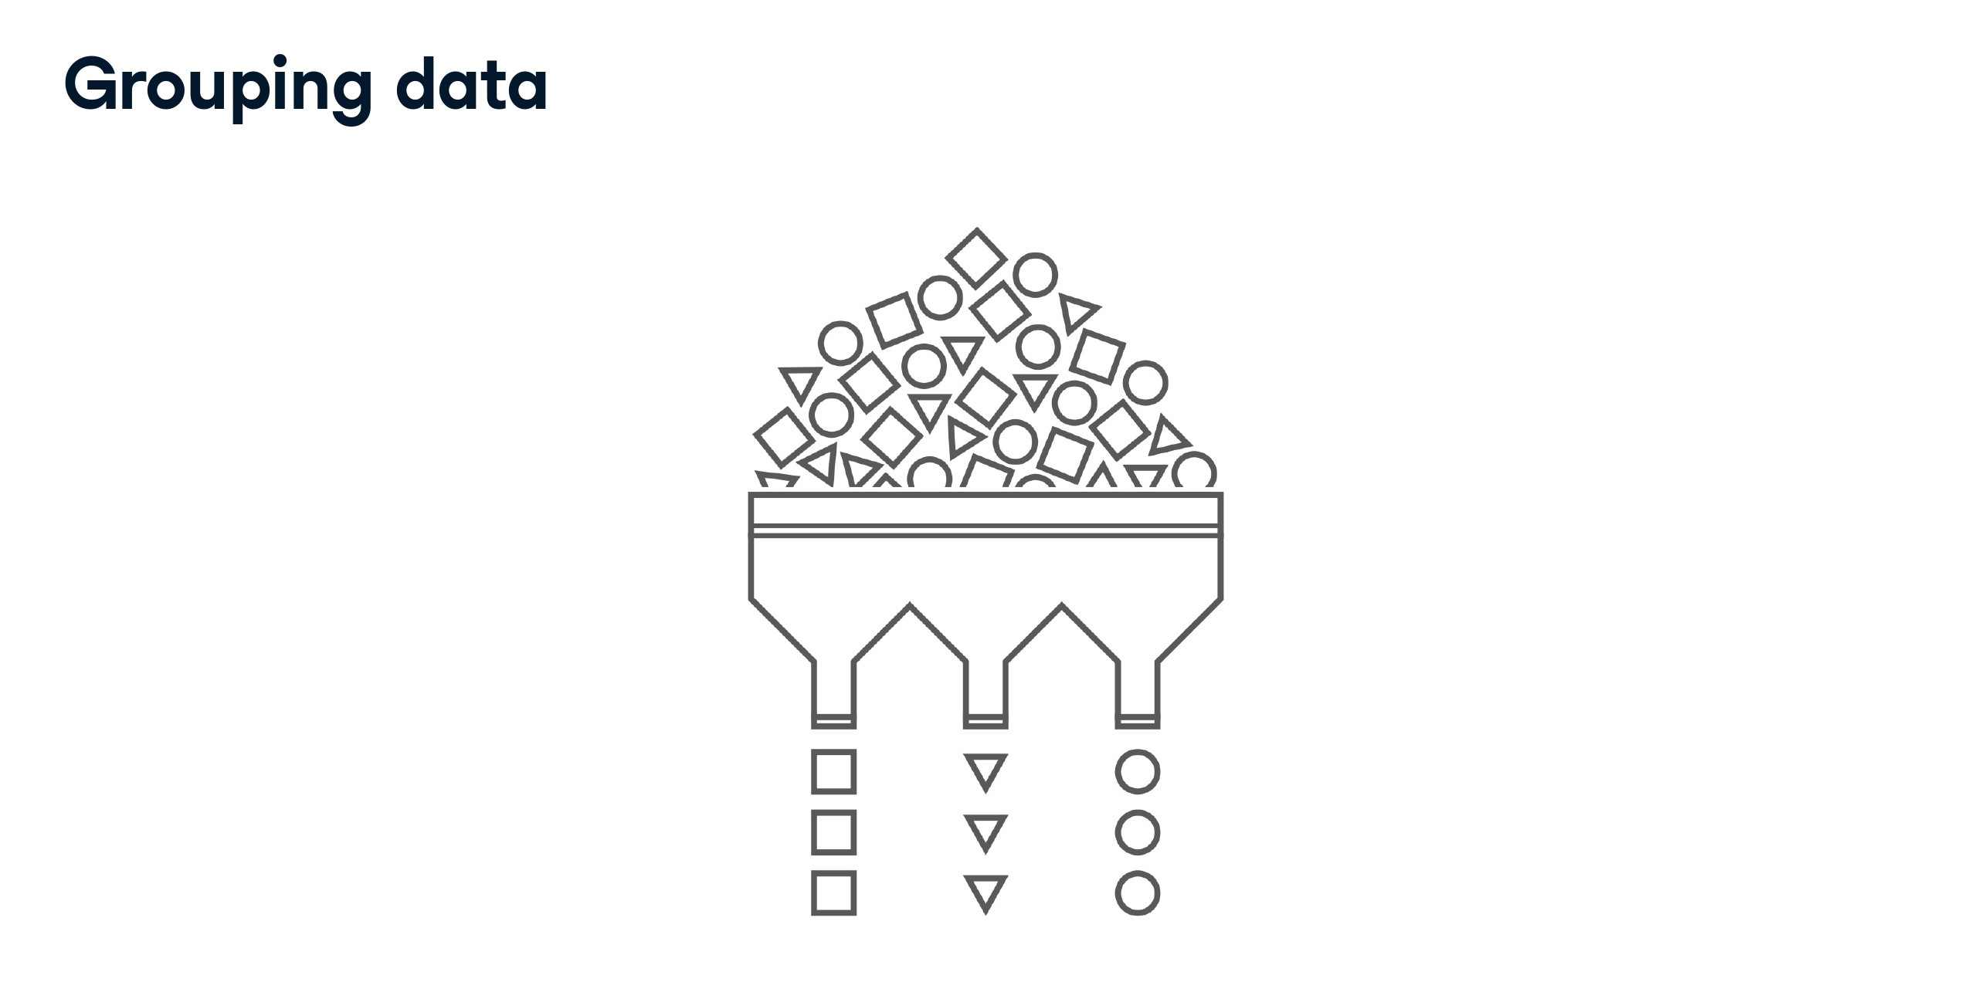

Slide 17
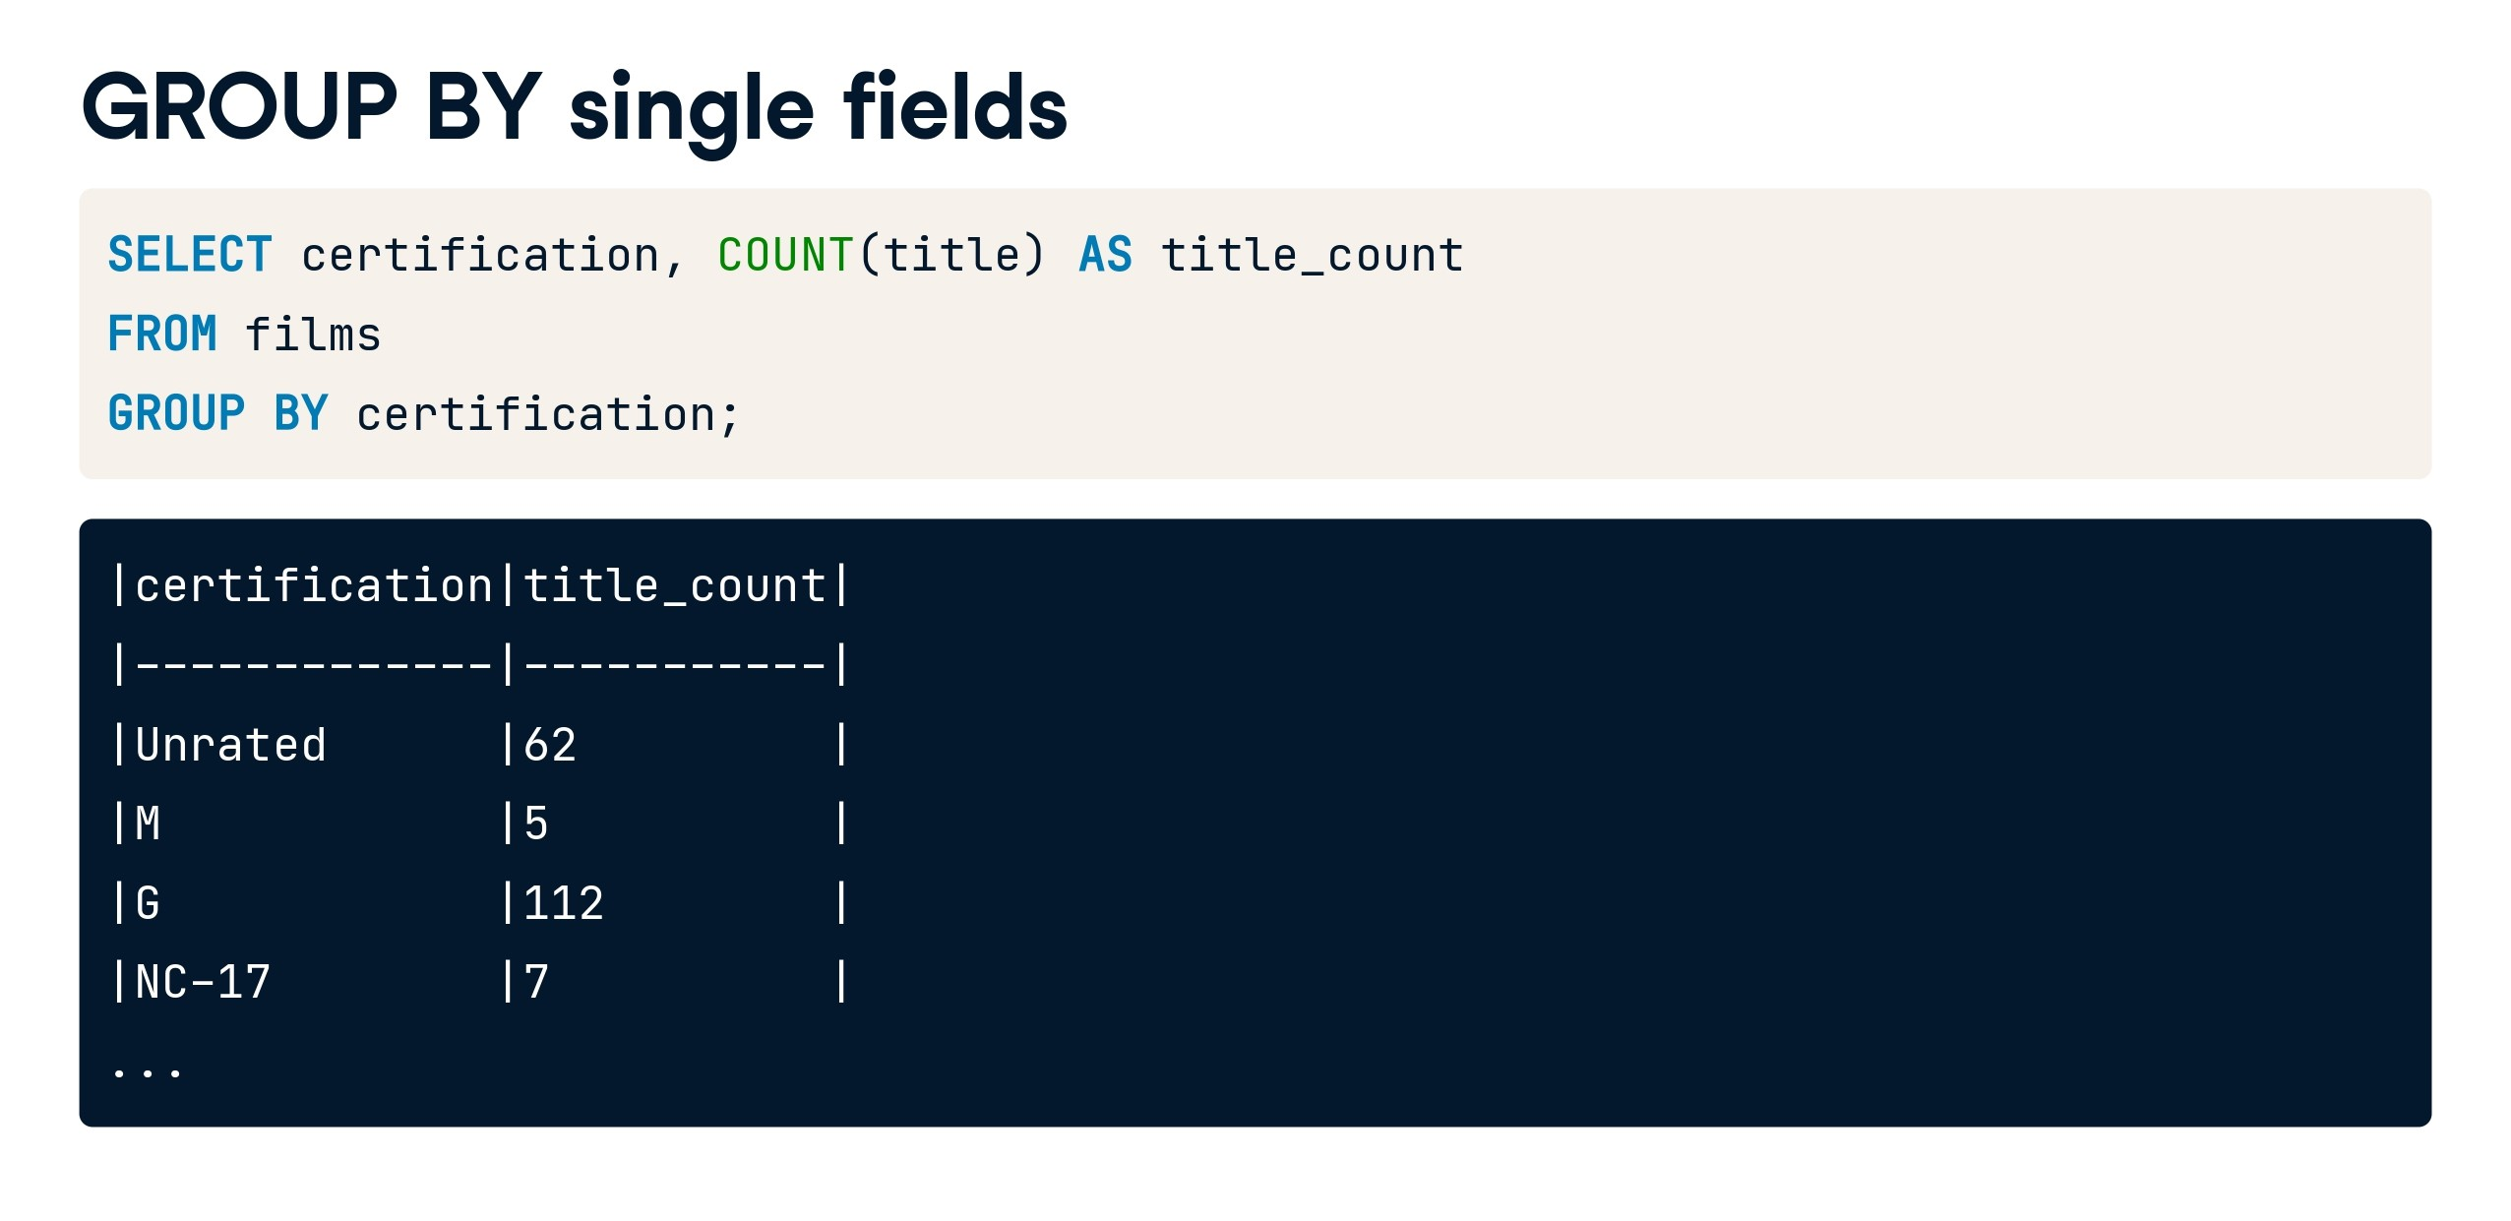

Slide 18

Case Study 3:
Retrieve the count of employees in each department from the 'Employee' table and display the department name along with the corresponding count.

Slide 19
Solution:
SELECT department, count(*)
FROM Employee
group BY department;

Slide 20
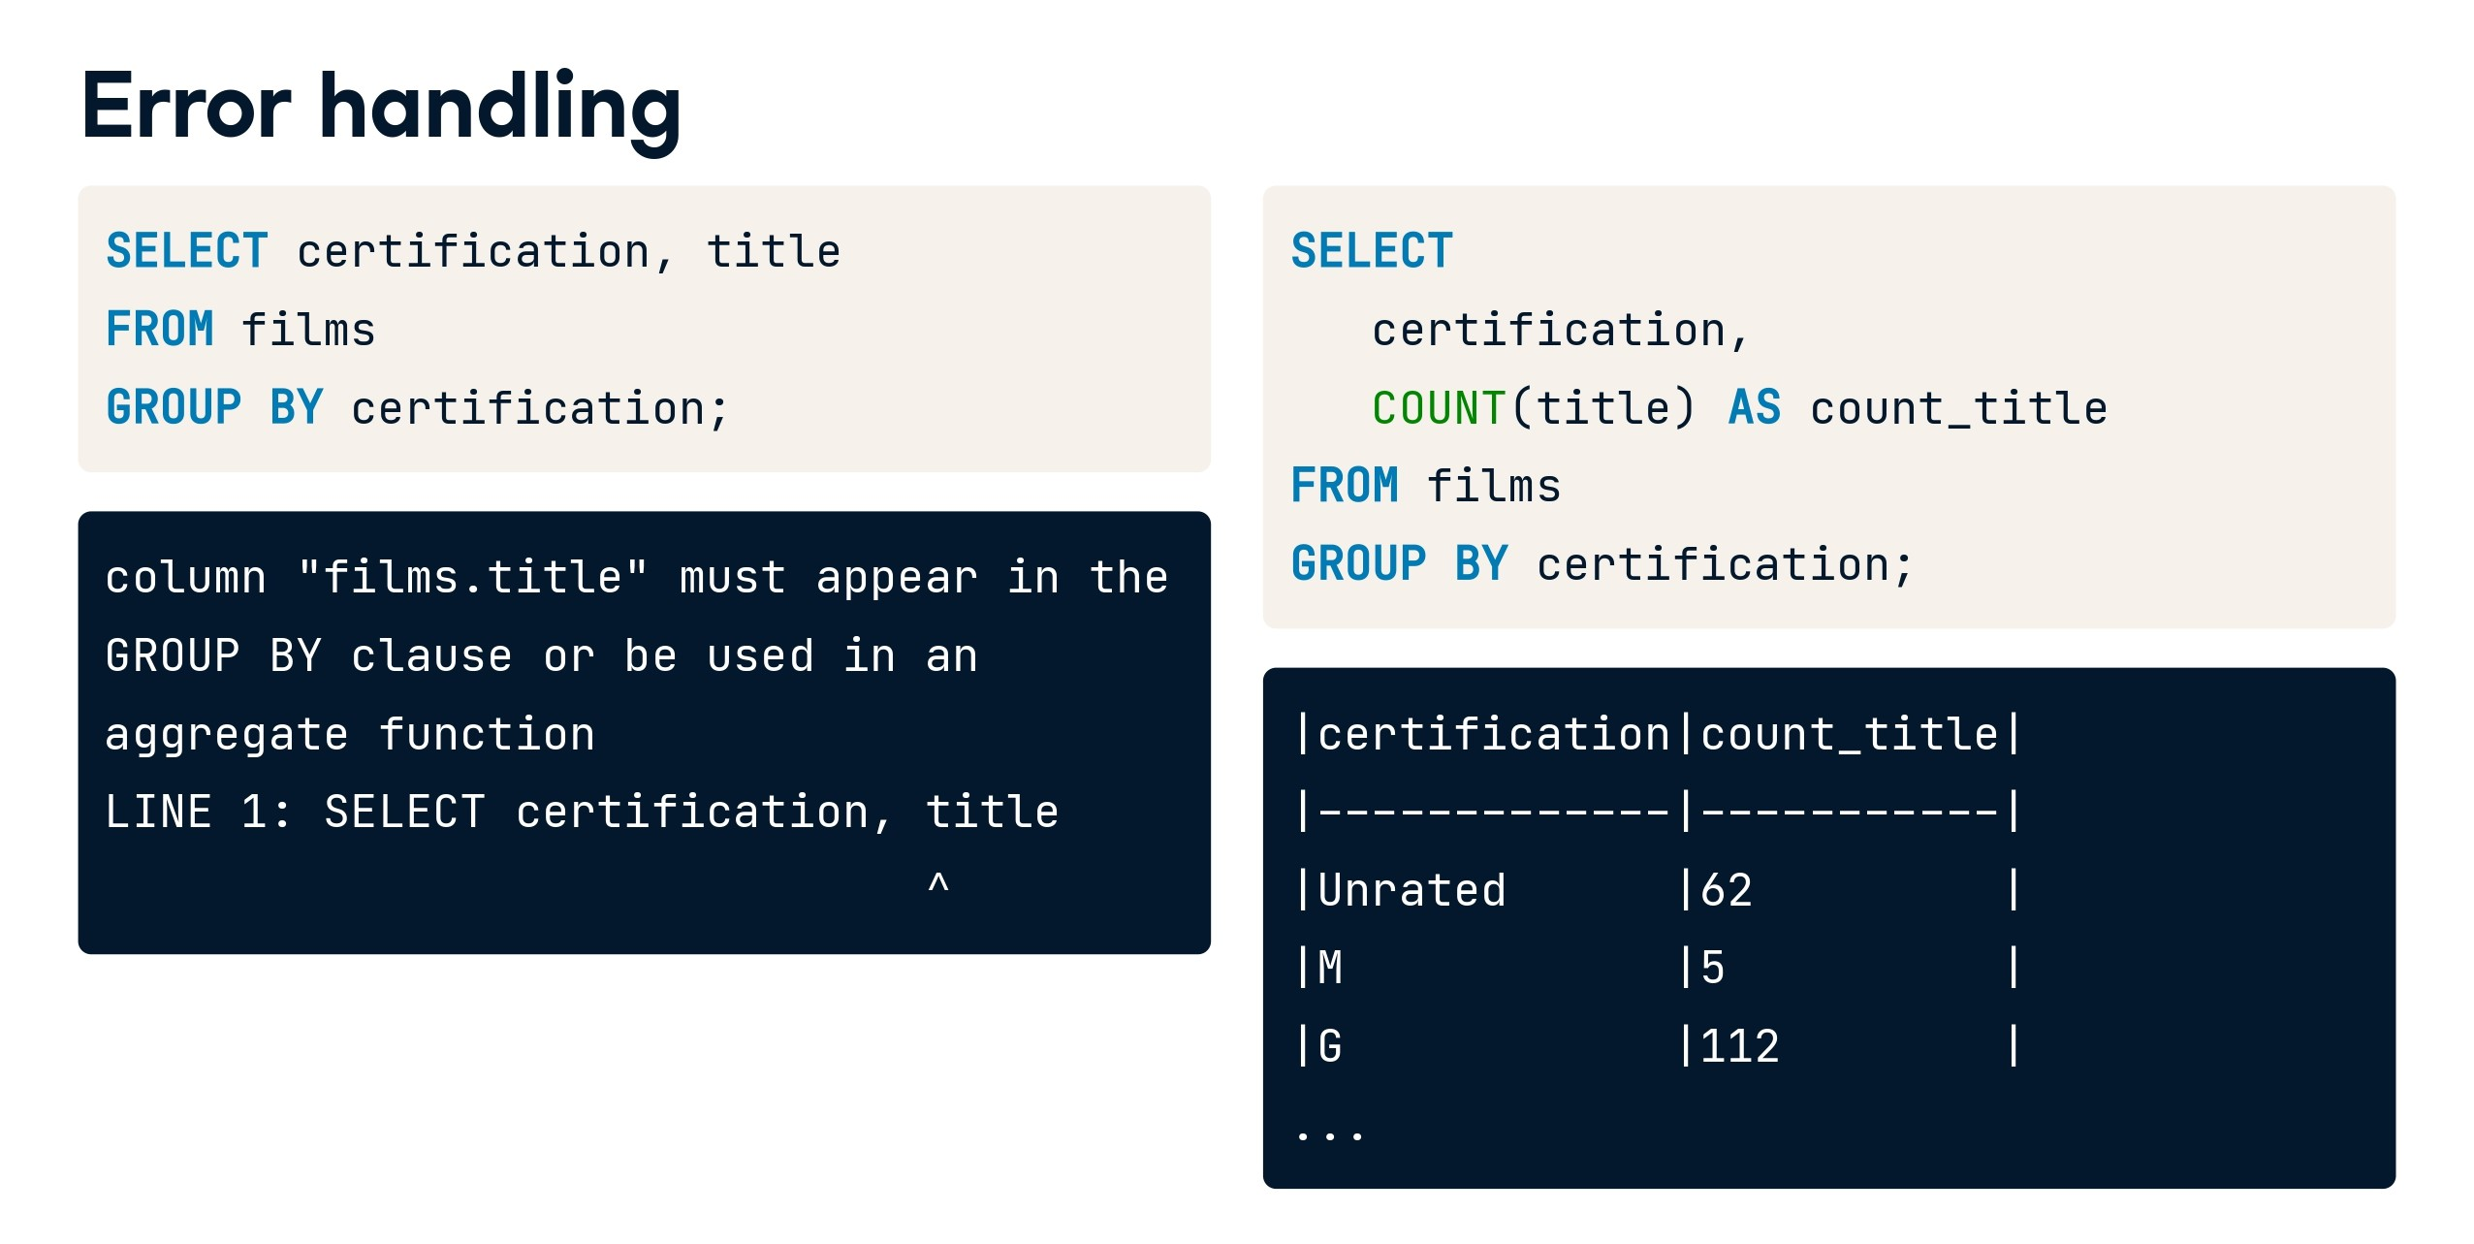

Slide 21
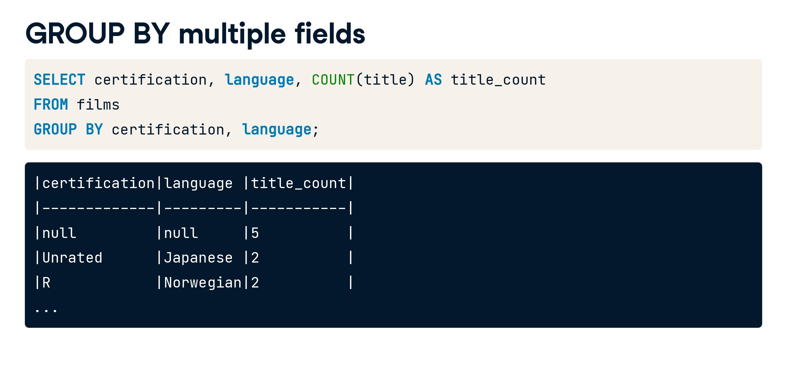

Slide 22
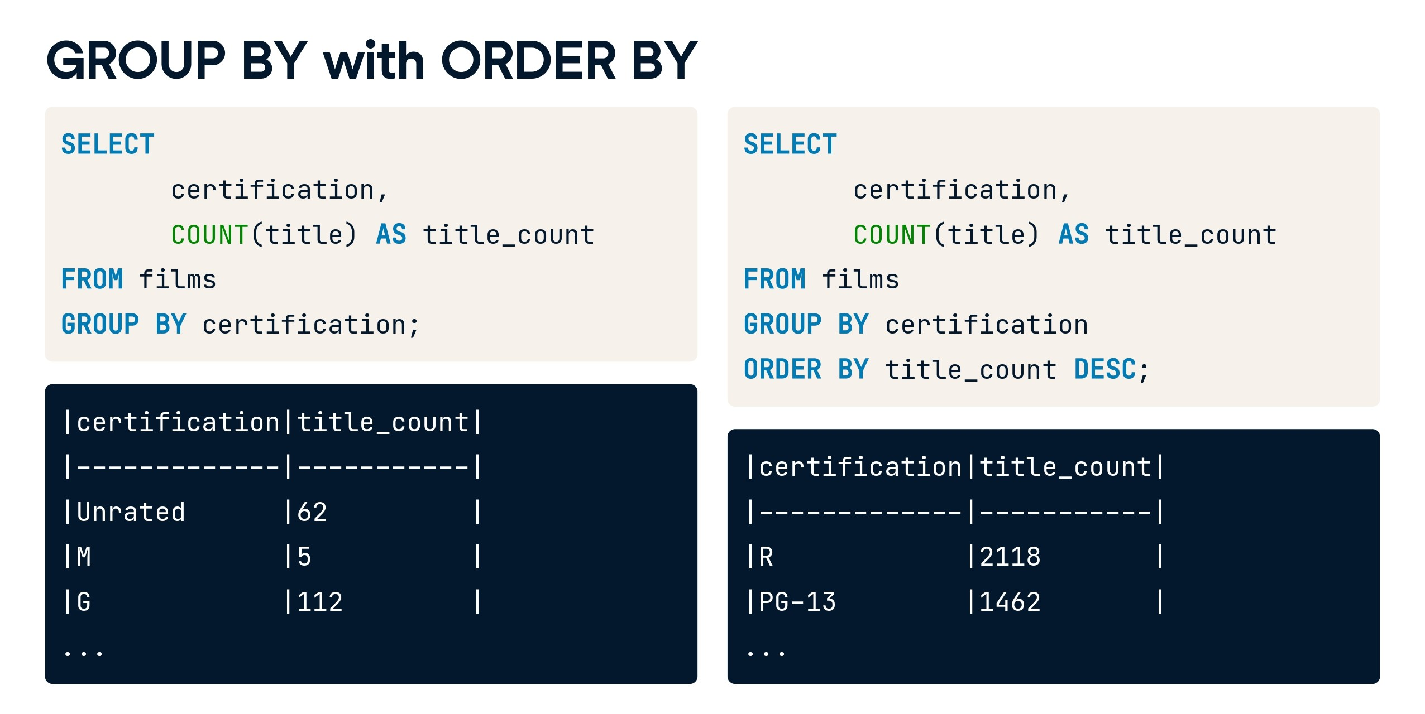

Slide 23
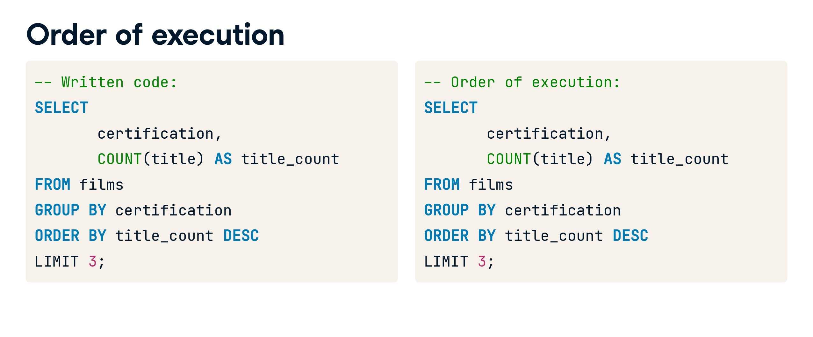

Slide 24
Case Study 4:
write an SQL query to find the departments with an average salary greater than $70,000. The query should return the department name, the total number of employees in each department, and the average salary of employees in each department. Sort the results in descending order based on the average salary.

Slide 25
Solution:
SELECT
department,
COUNT(*) AS total_employees,
AVG(salary) AS average_salary
FROM Employees1
WHERE salary > 70000
GROUP BY department
ORDER BY average_salary DESC;

Slide 26
Case Study 5:
Retrieve a summary report from the 'Employees' table that shows the following information for each department and position combination:
Number of employees in each department and position (num_employees)
Average salary of employees in each department and position (avg_salary)
Maximum salary of employees in each department and position (max_salary)
Minimum salary of employees in each department and position (min_salary)
Total years of experience of employees in each department and position (total_years_of_exp)
Present the results in ascending order of department and position.

Slide 27
Solution:
SELECT
department,
position,
COUNT(emp_id) AS num_employees,
AVG(salary) AS avg_salary,
MAX(salary) AS max_salary,
MIN(salary) AS min_salary,
SUM(years_of_exp) AS total_years_of_exp
FROM Employees
GROUP BY department, position
ORDER BY department, position;

Slide 28


Slide 29
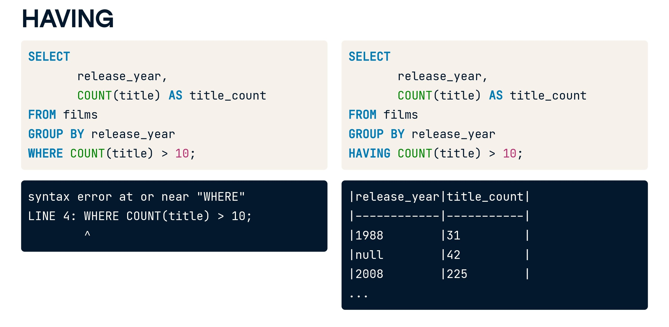

Slide 30
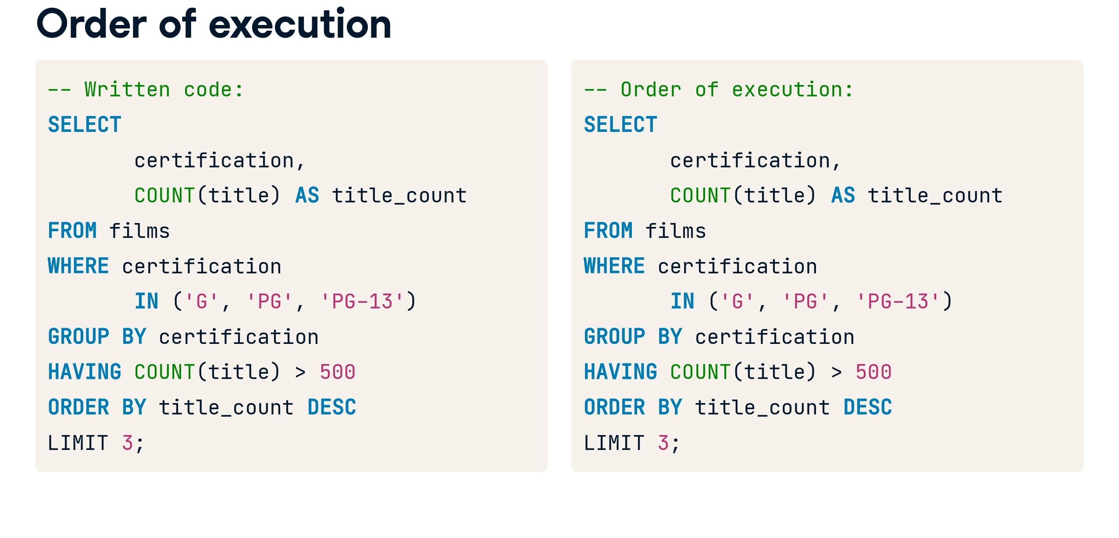

Slide 31
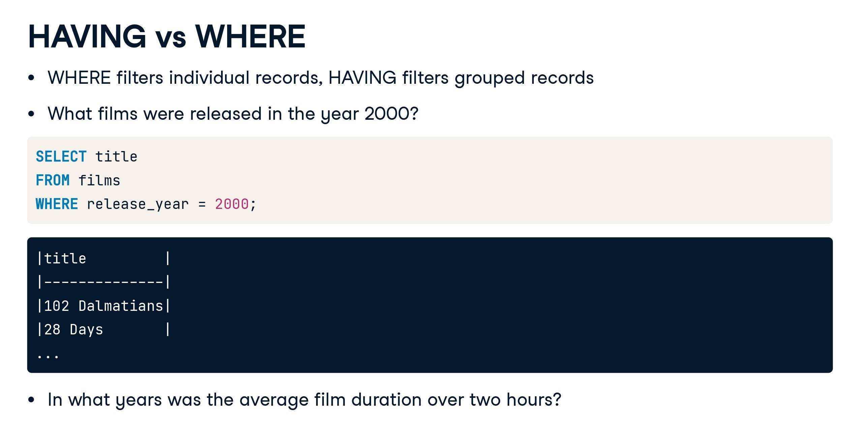

Slide 32
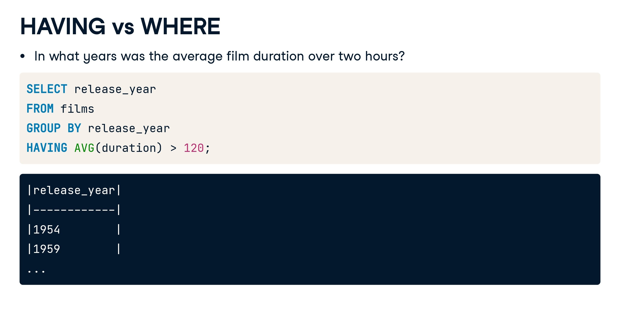

Slide 33
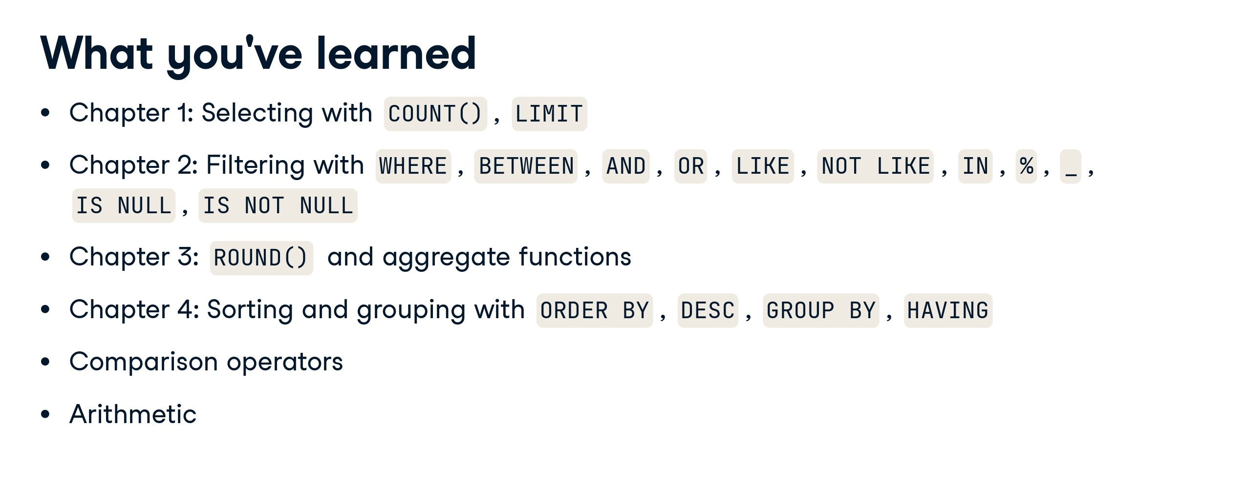

Slide 34
Case Study 6:
Find the departments where the average salary of employees with at least 5 years of experience is greater than $50,000. Retrieve the department name and the corresponding average salary. Sort the results in ascending order based on the department name and in descending order based on the average salary within each department.

Slide 35
Solution:
SELECT
department,
AVG(salary) AS average_salary
FROM
Employees
WHERE
years_of_exp >= 5
GROUP BY
department
HAVING
AVG(salary) > 50000
ORDER BY
department ASC,
average_salary DESC;

Slide 36


Slide 37
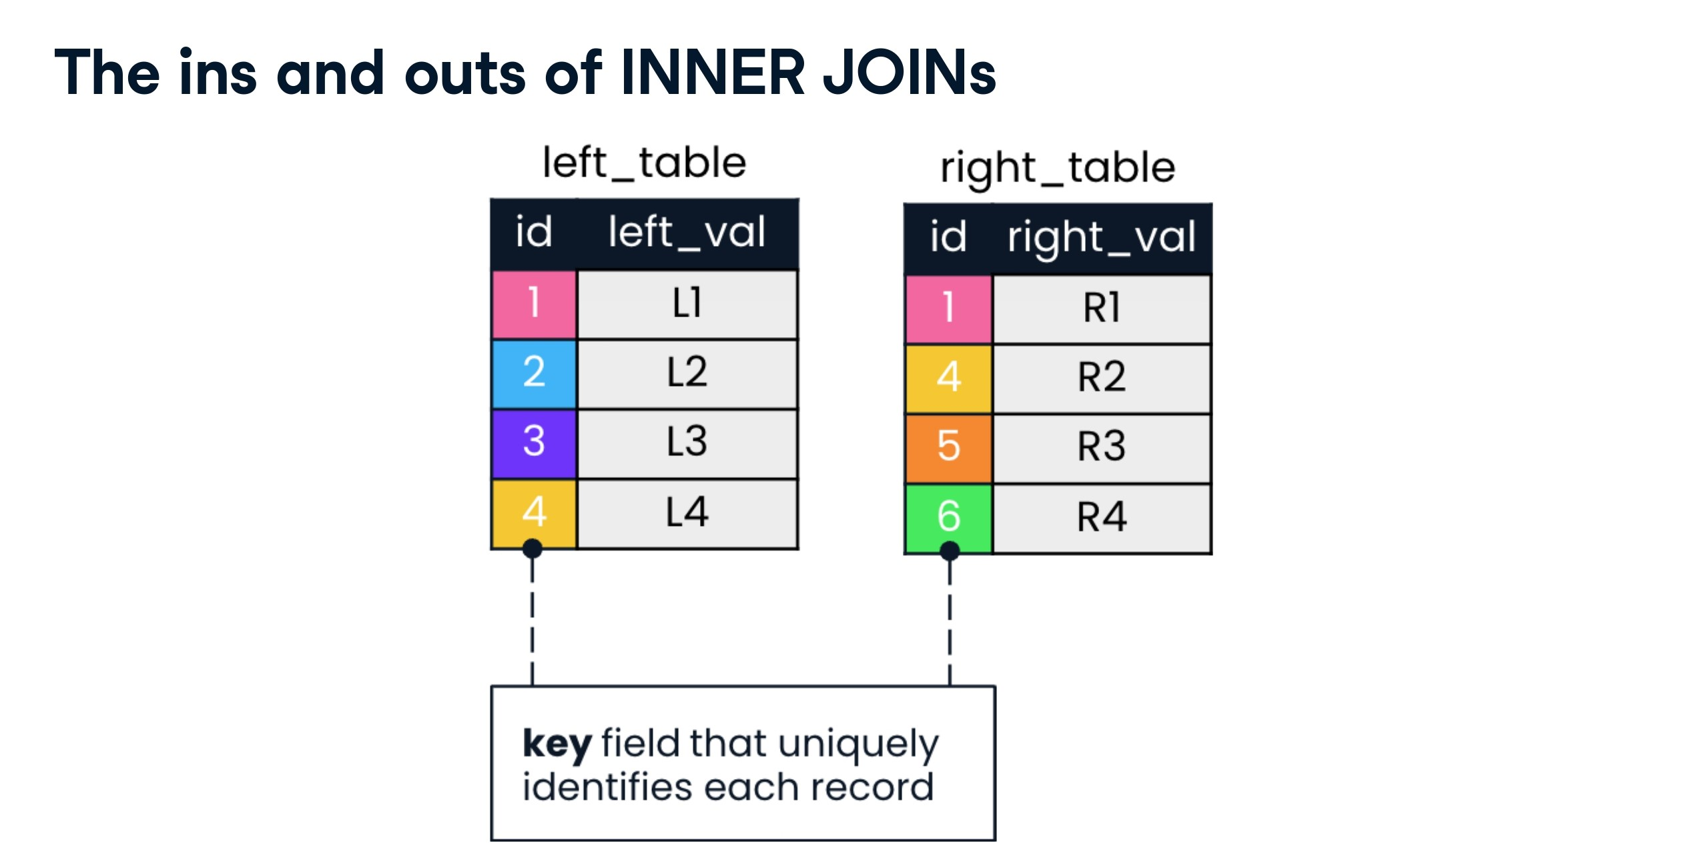

Slide 38
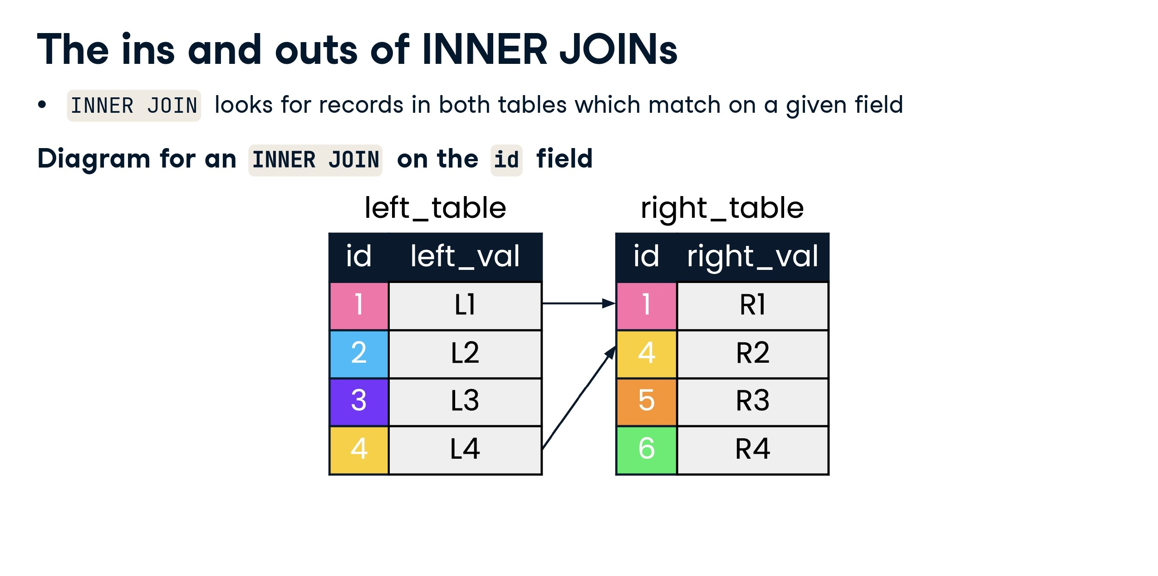

Slide 39
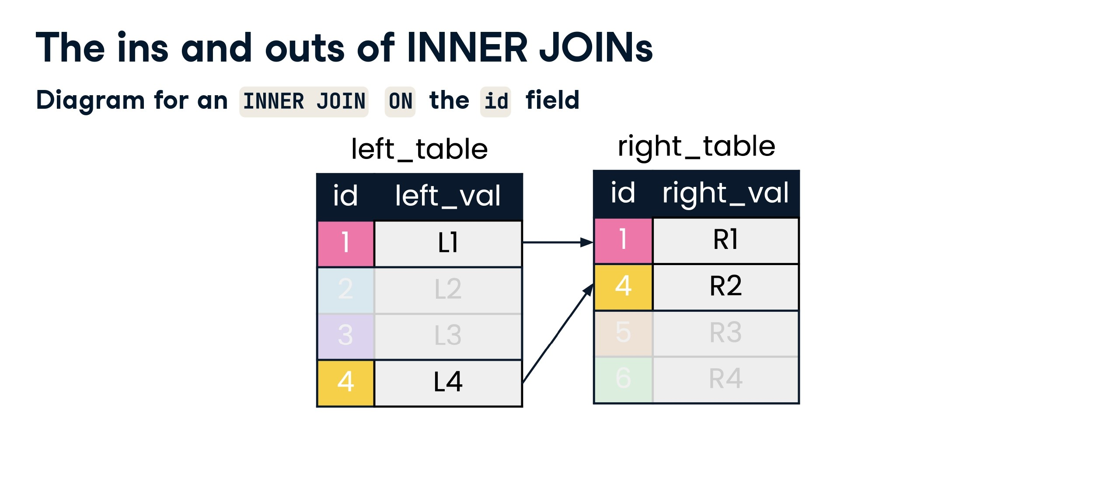

Slide 40
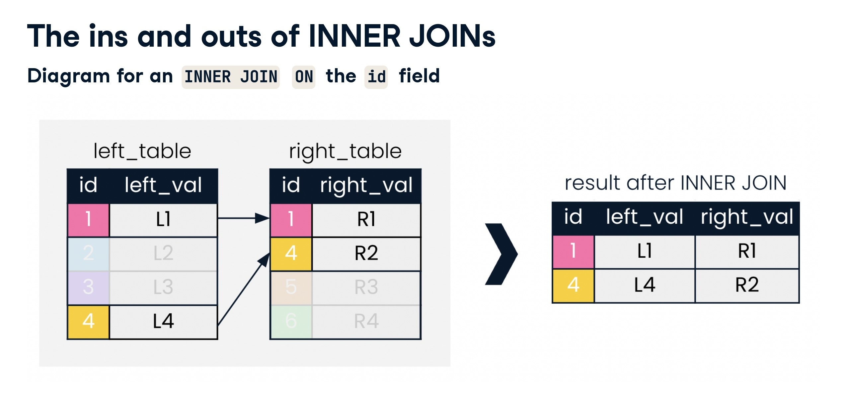

Slide 41
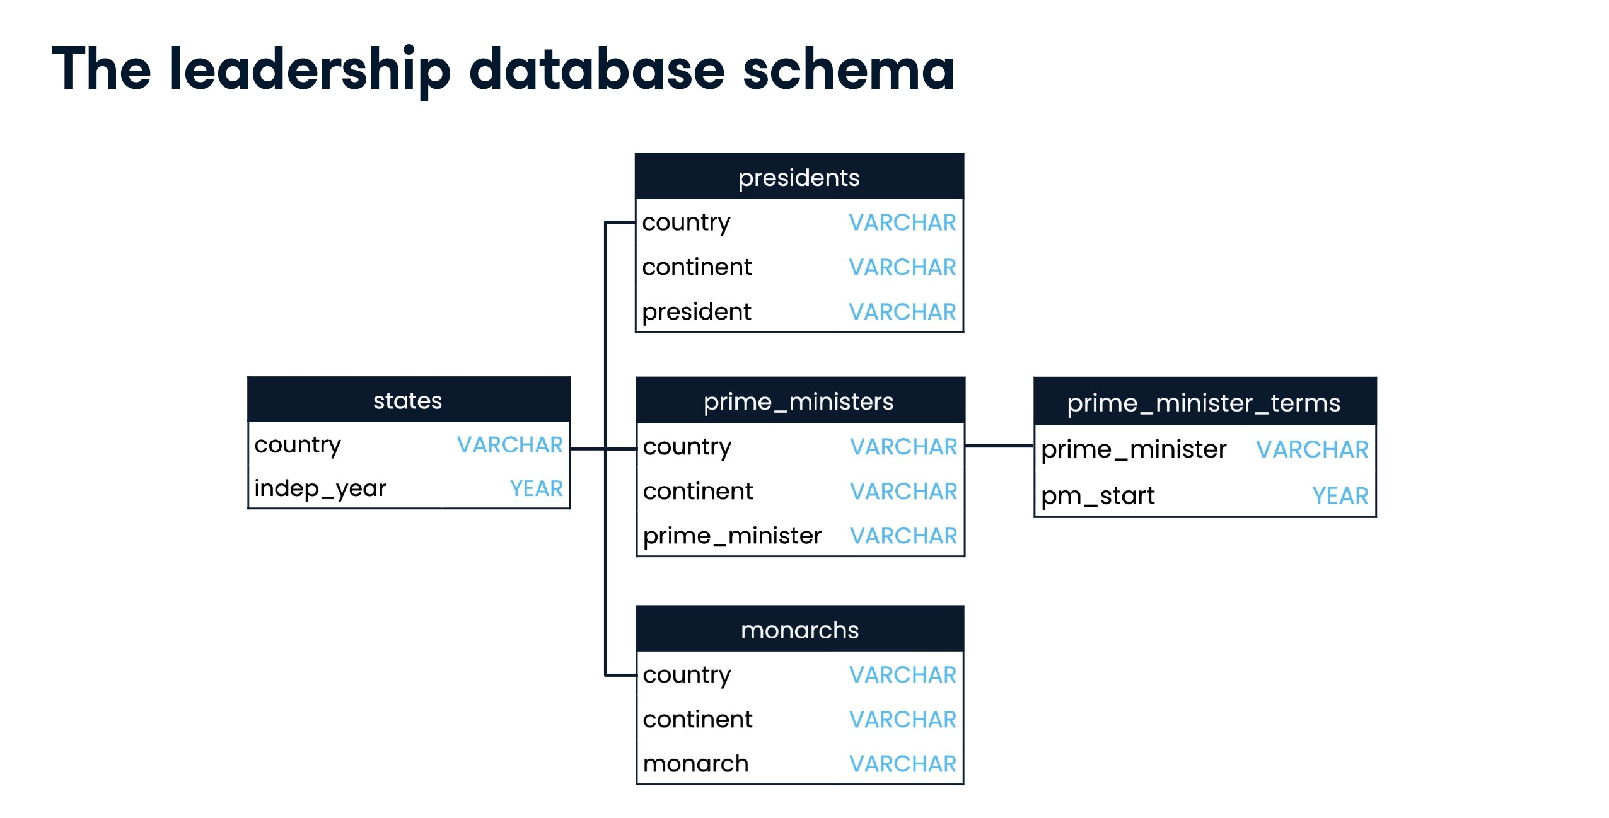

Slide 42
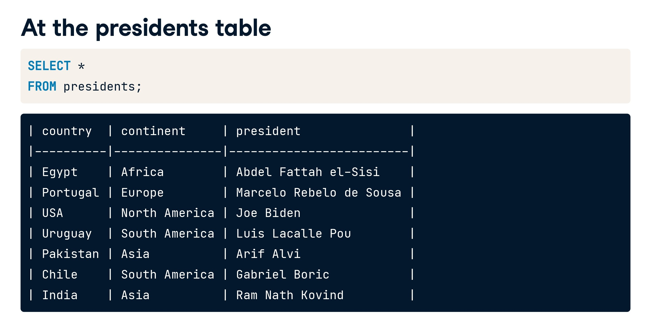

Slide 43
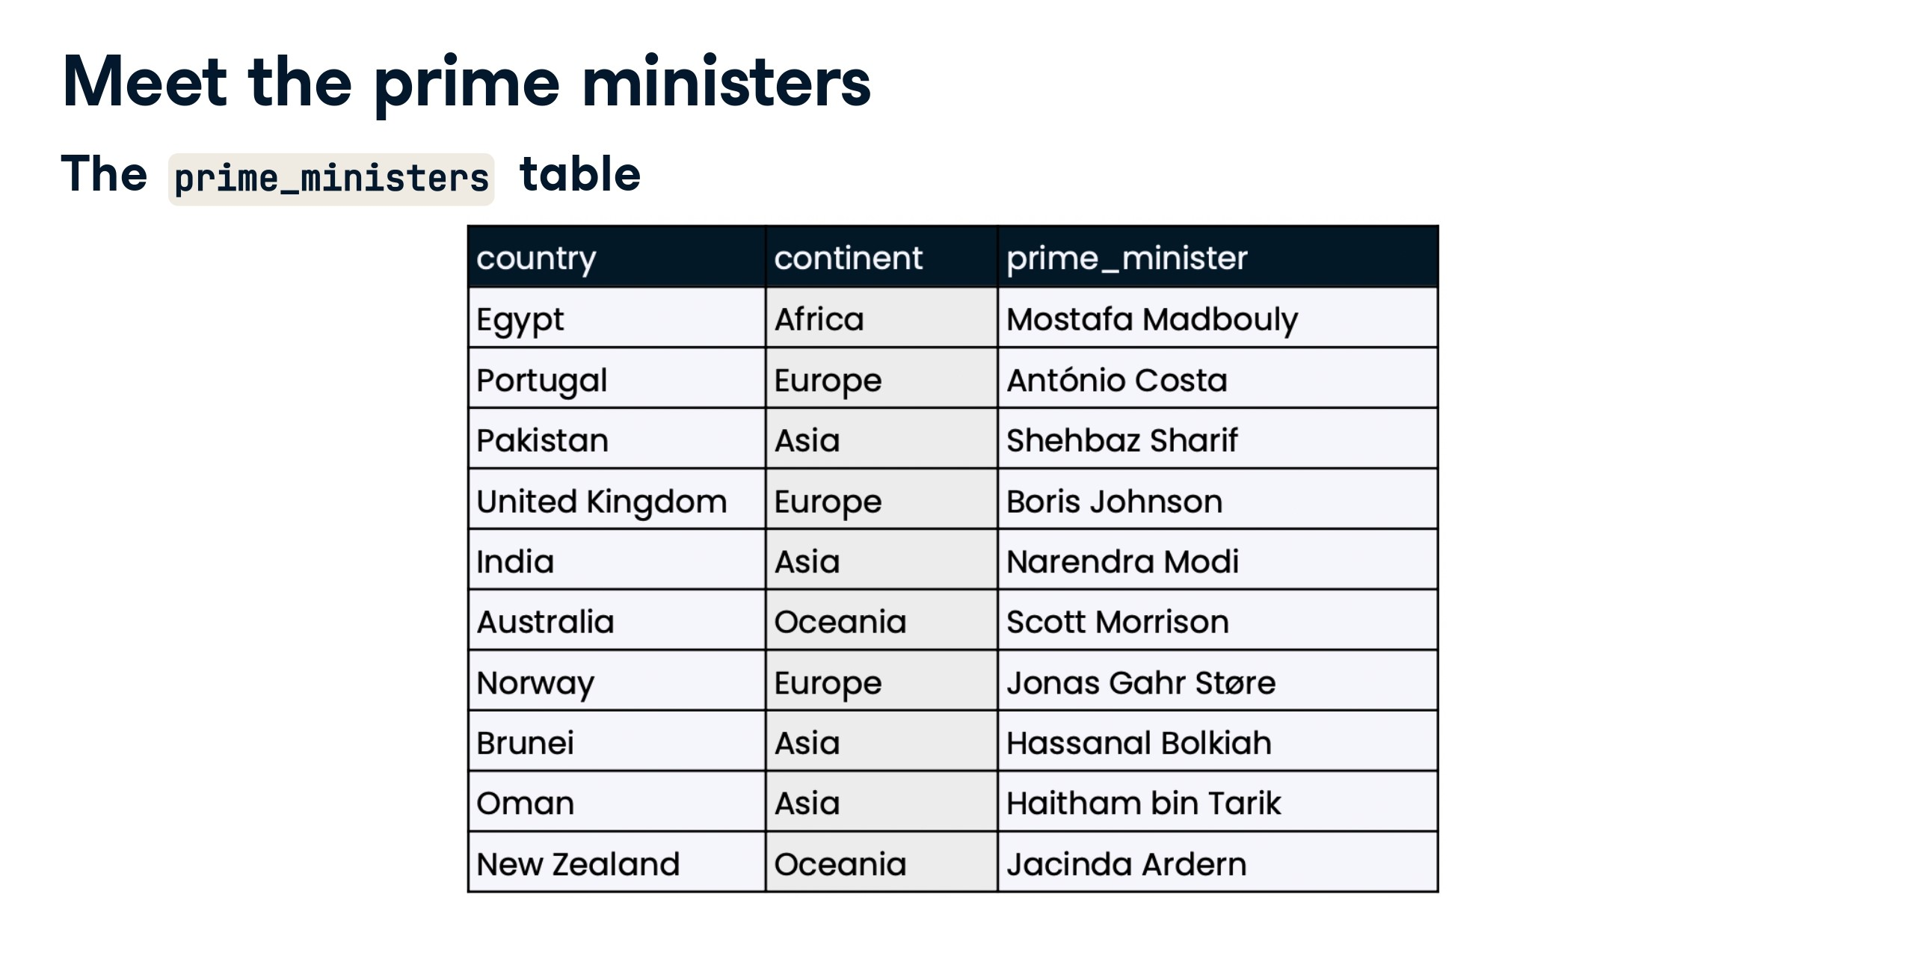

Slide 44
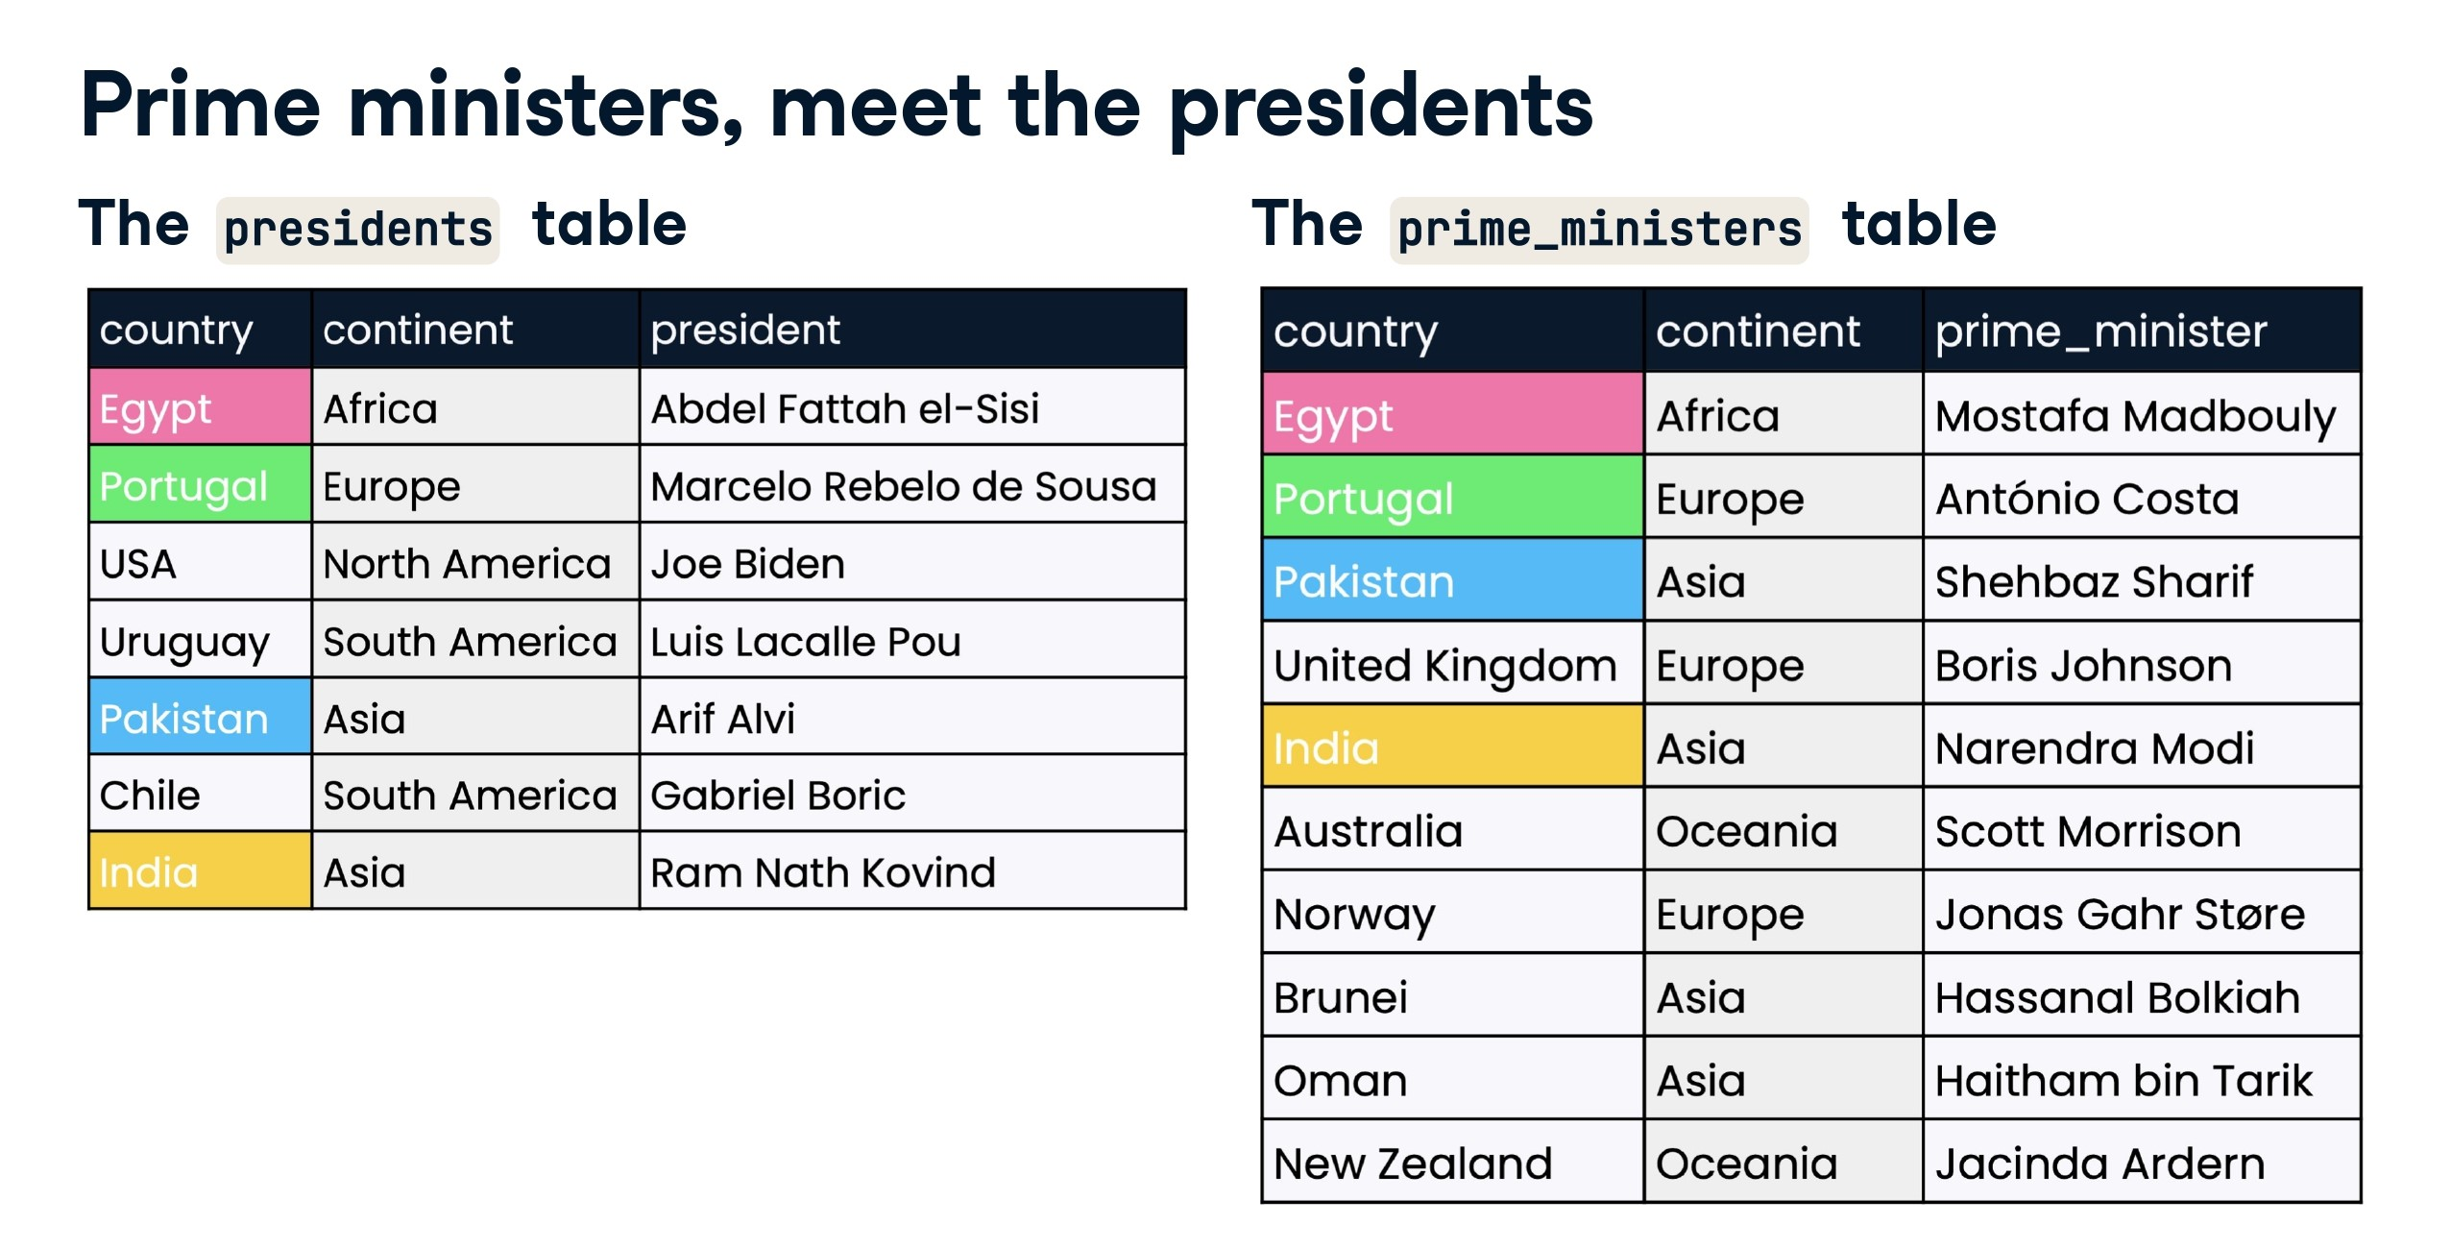

Slide 45
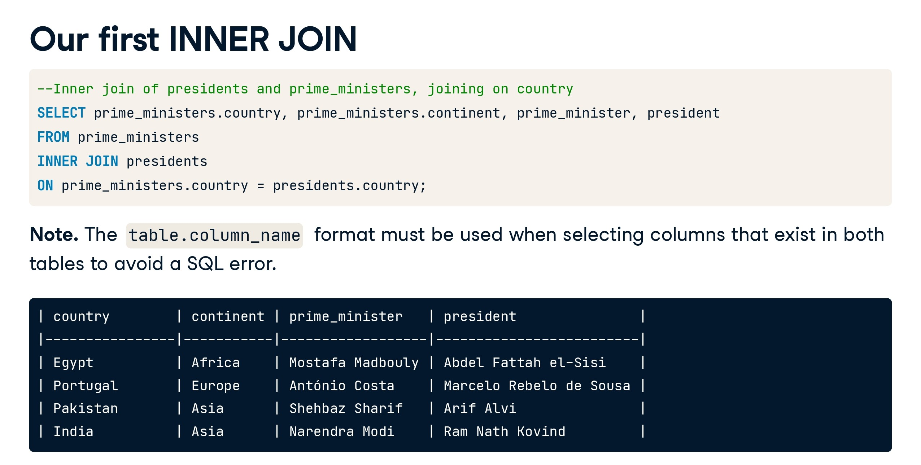

Slide 46
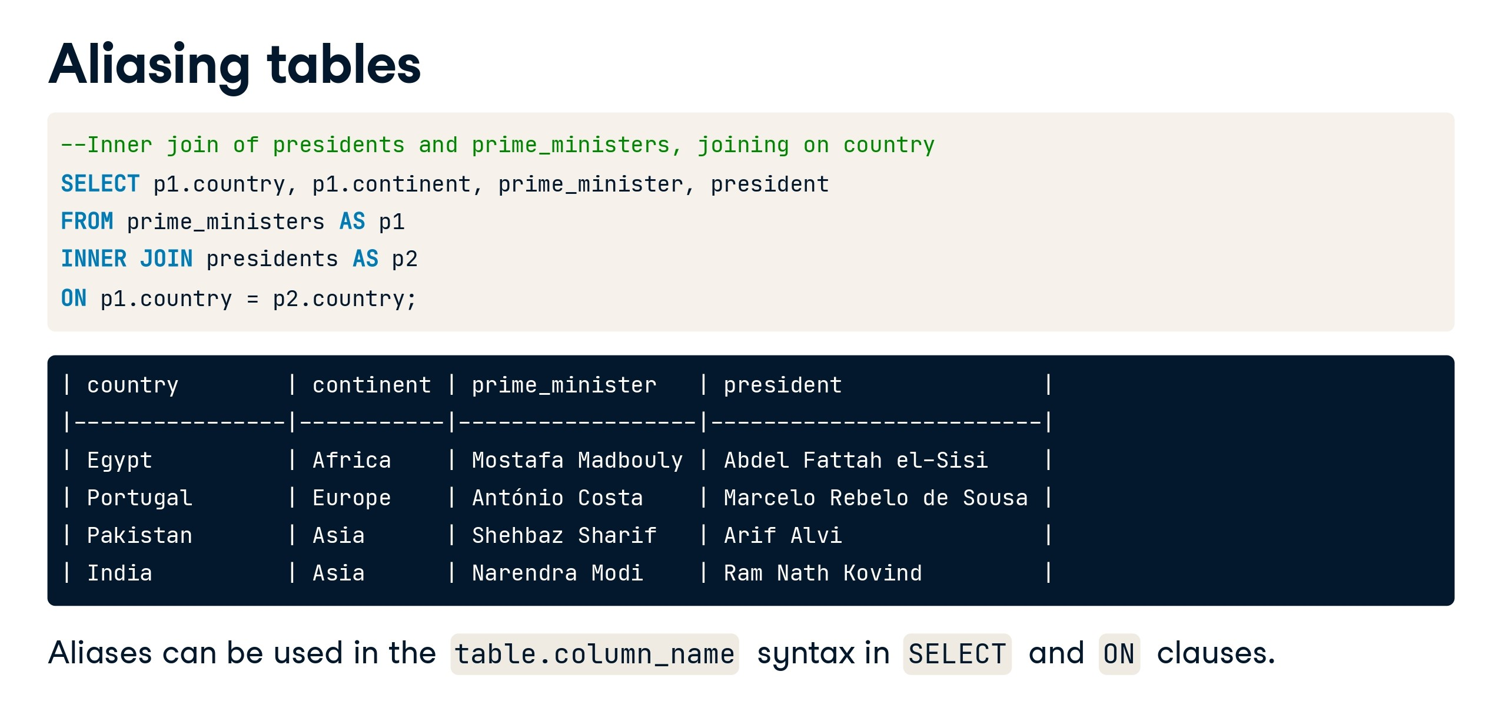

Slide 47
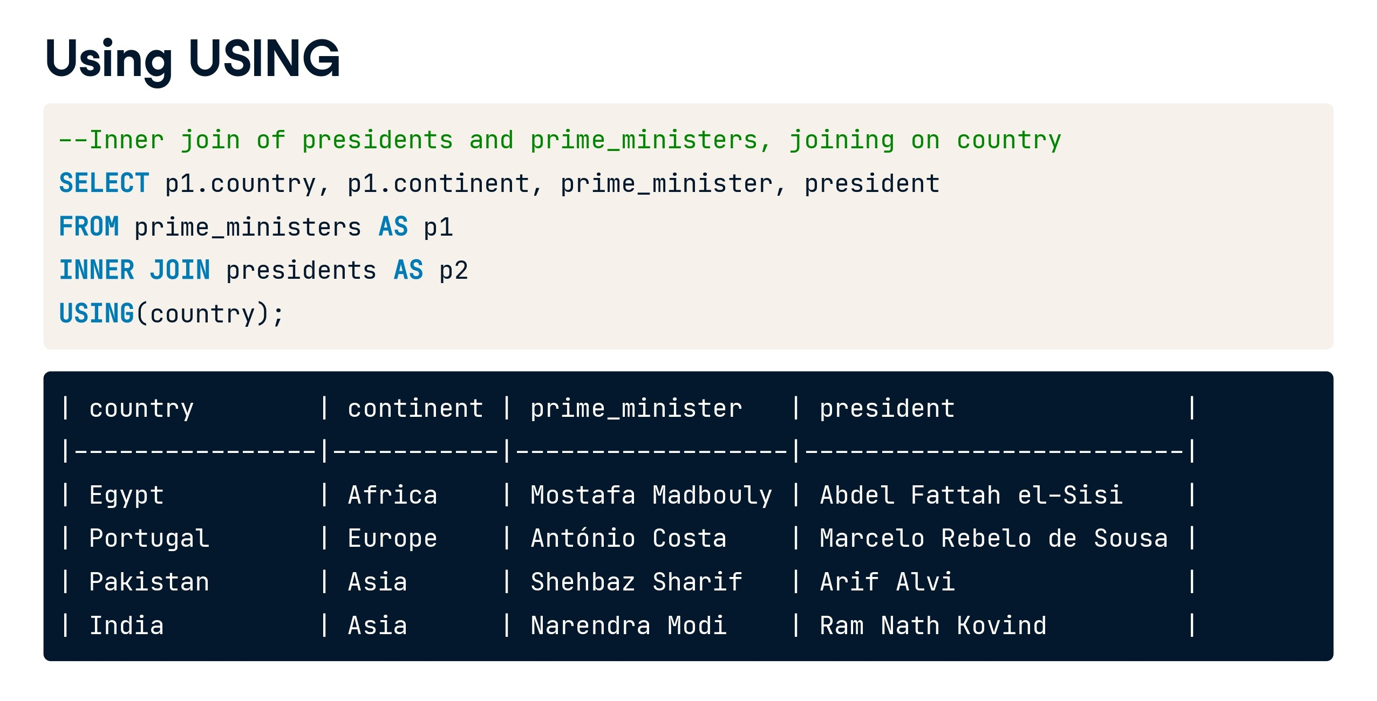

Slide 48


Slide 49
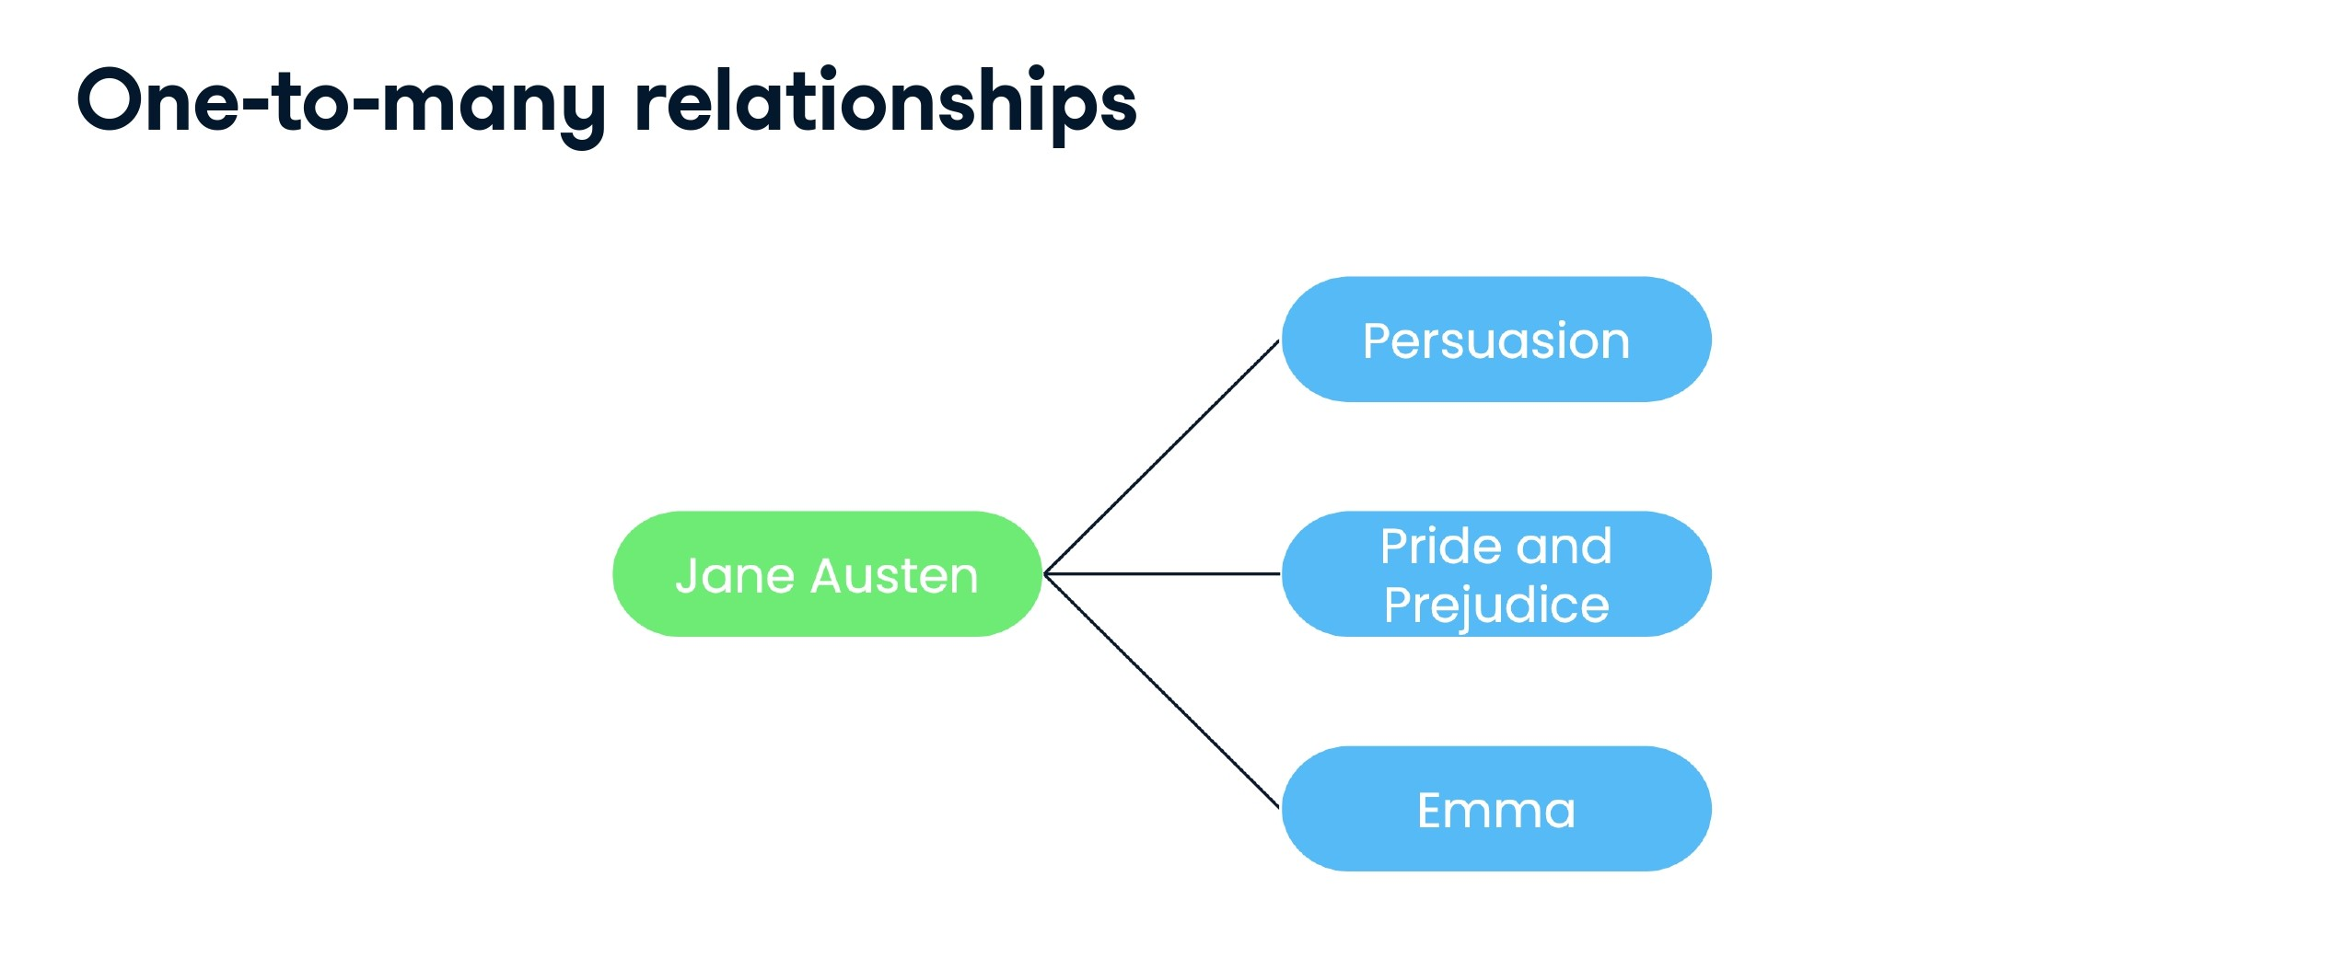

Slide 50
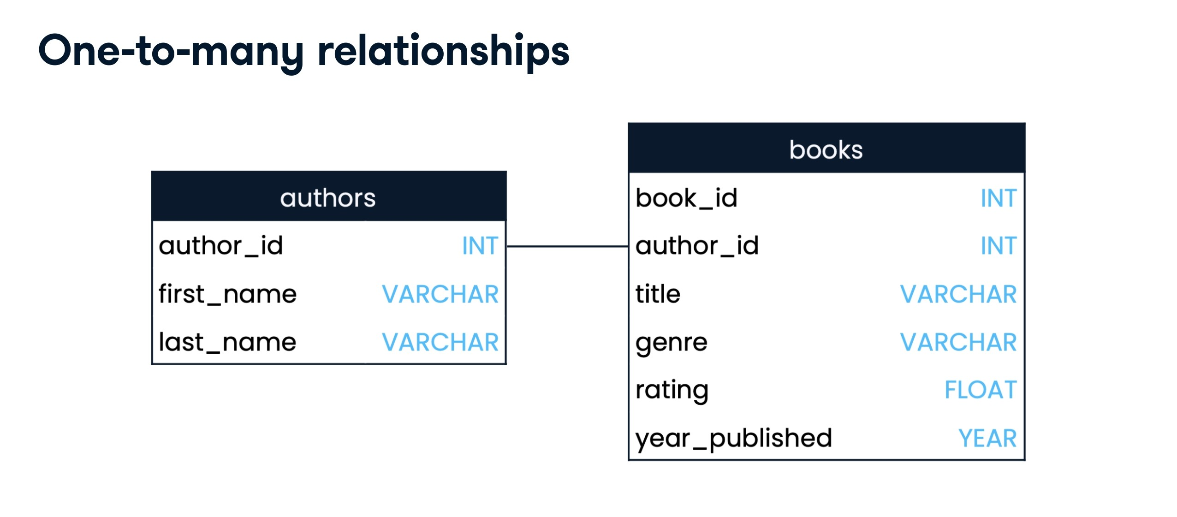

Slide 51


Slide 52
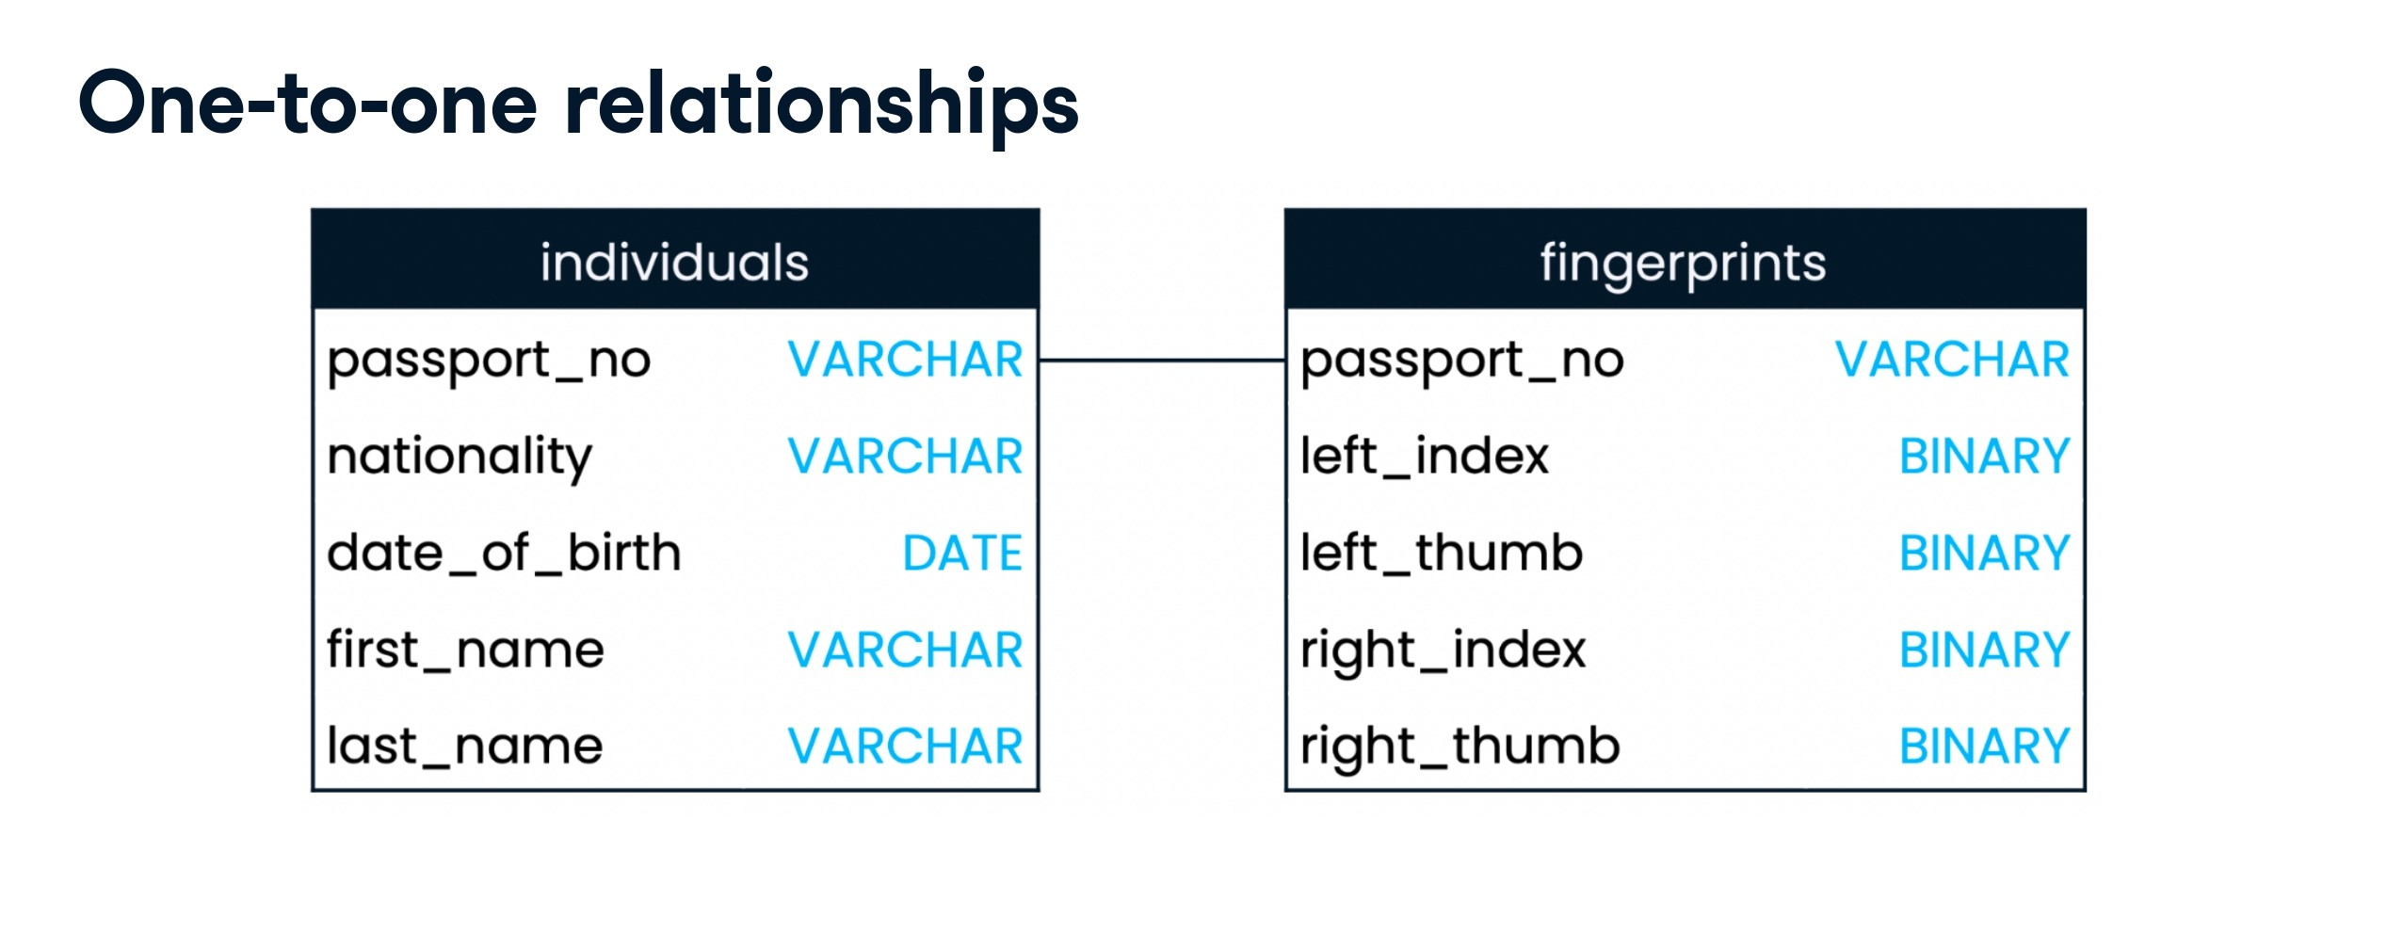

Slide 53
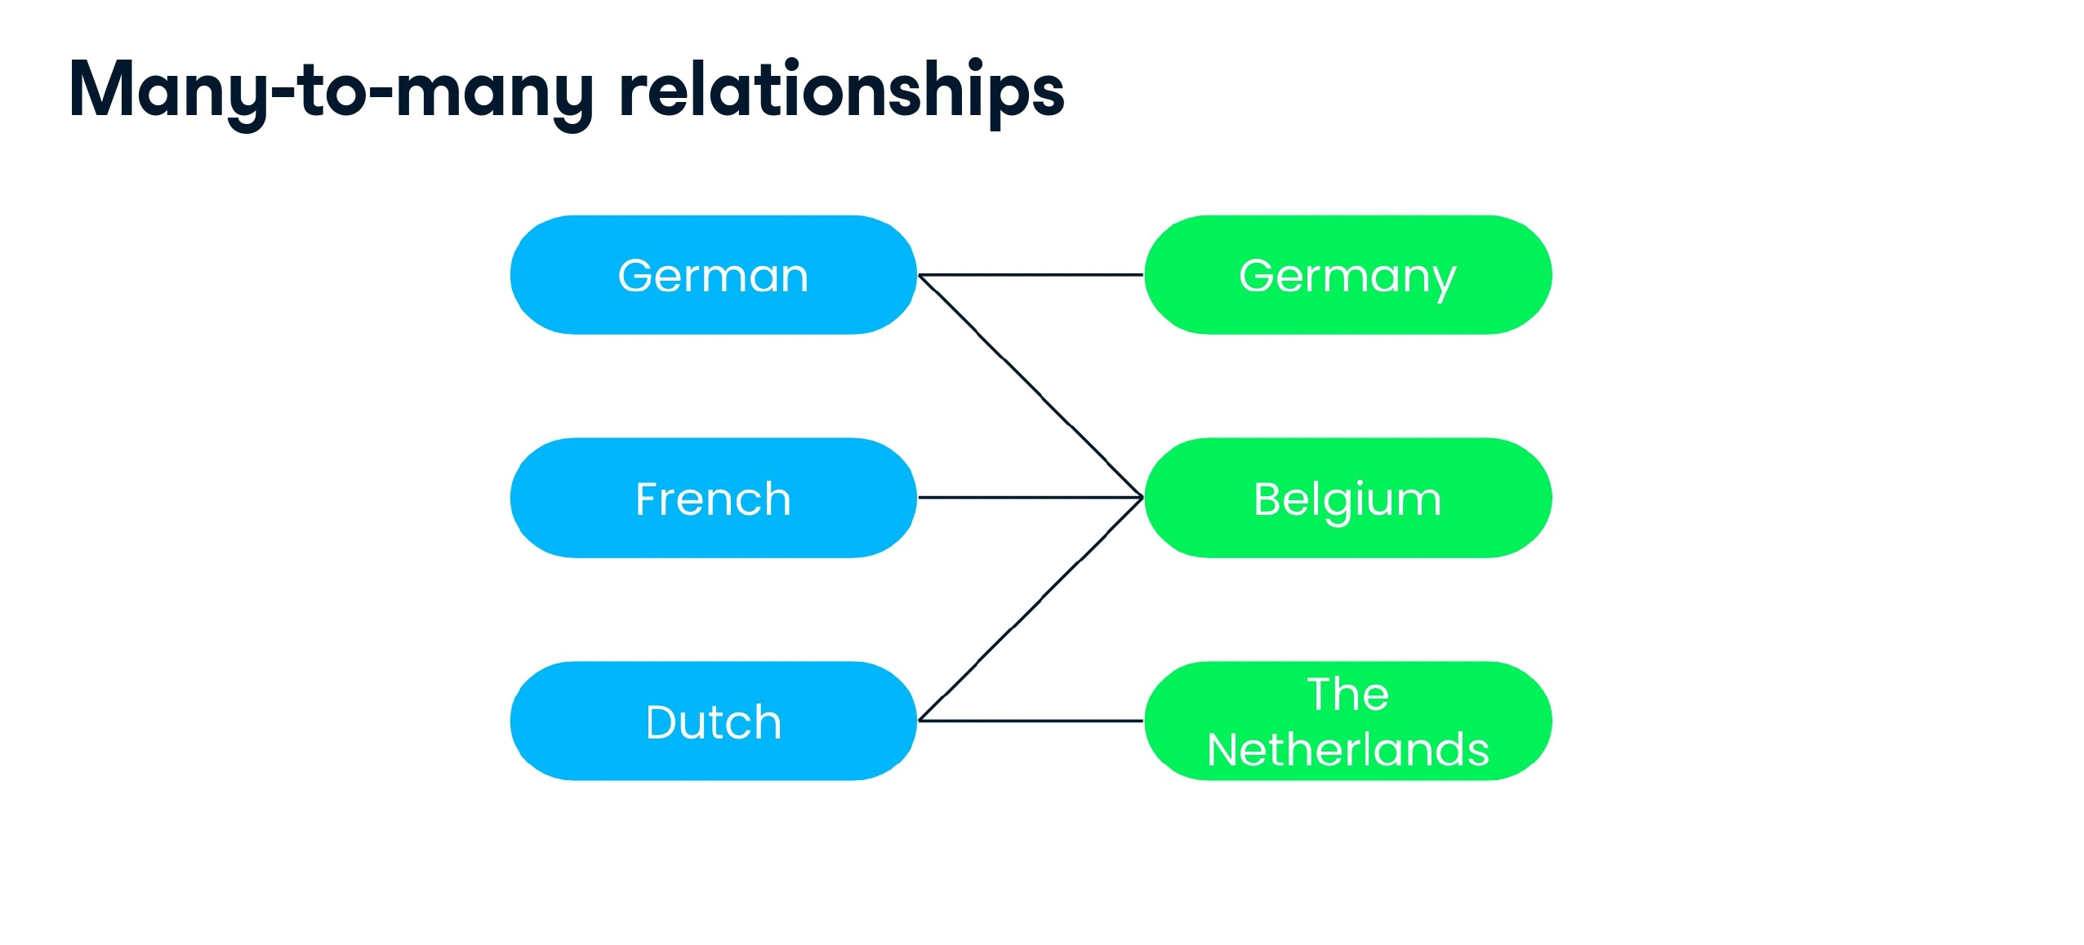

Slide 54


Slide 55
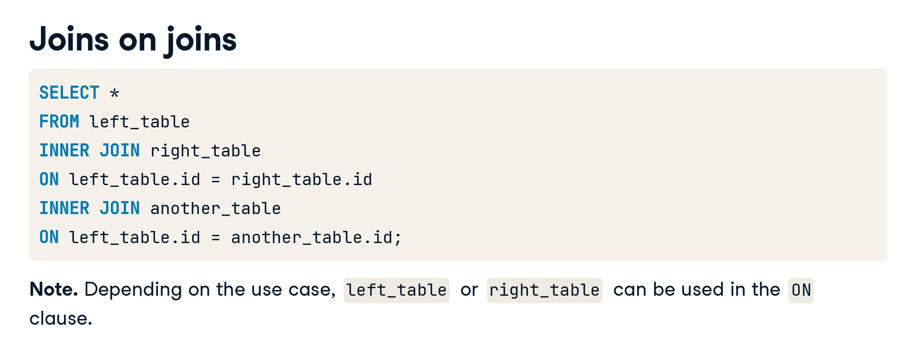

Slide 56
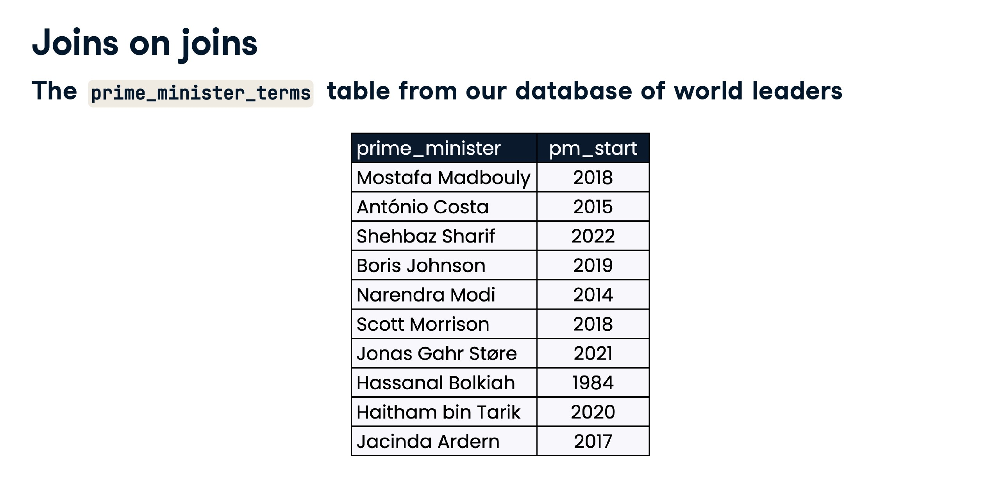

Slide 57
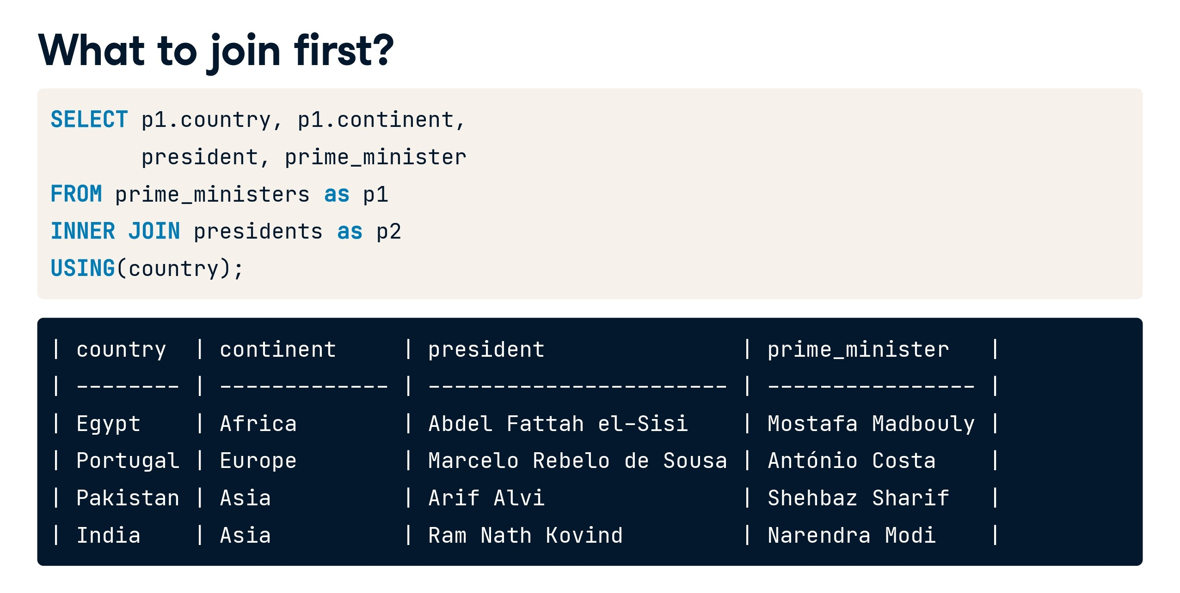

Slide 58
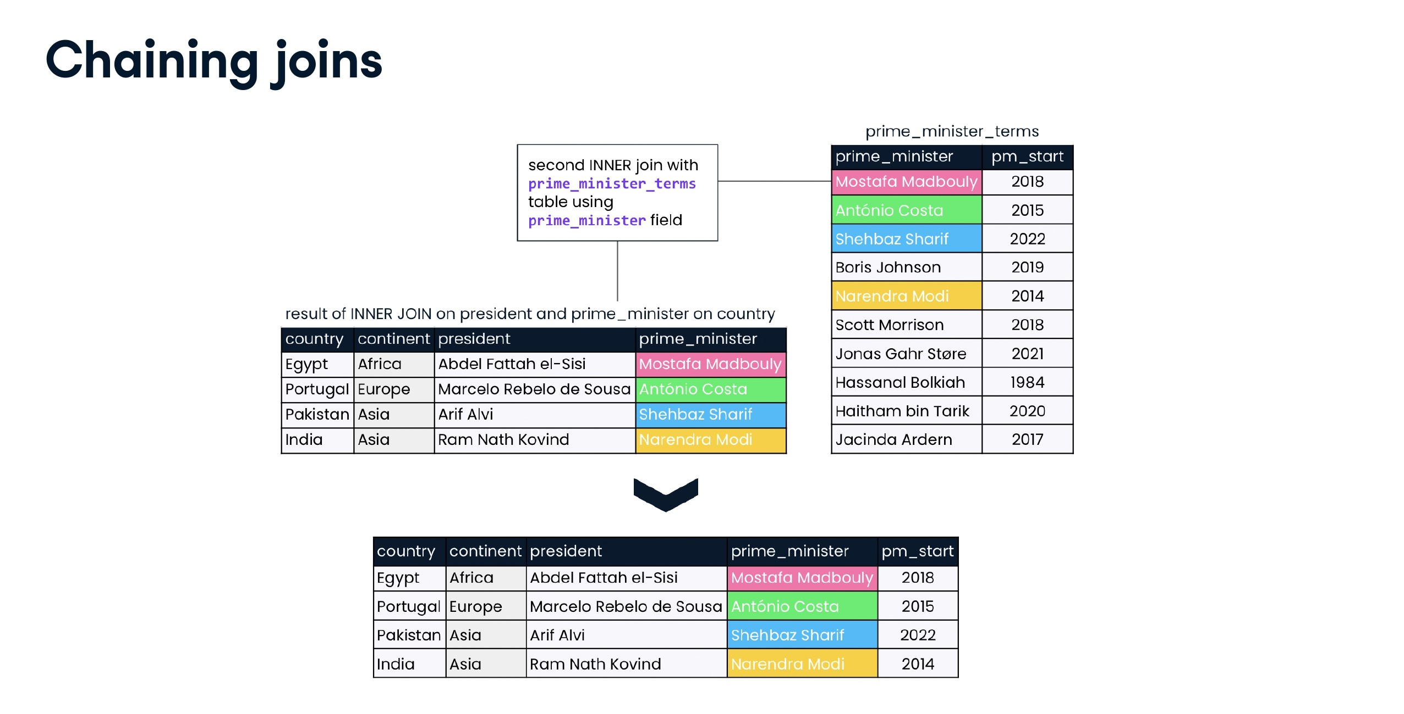

Slide 59
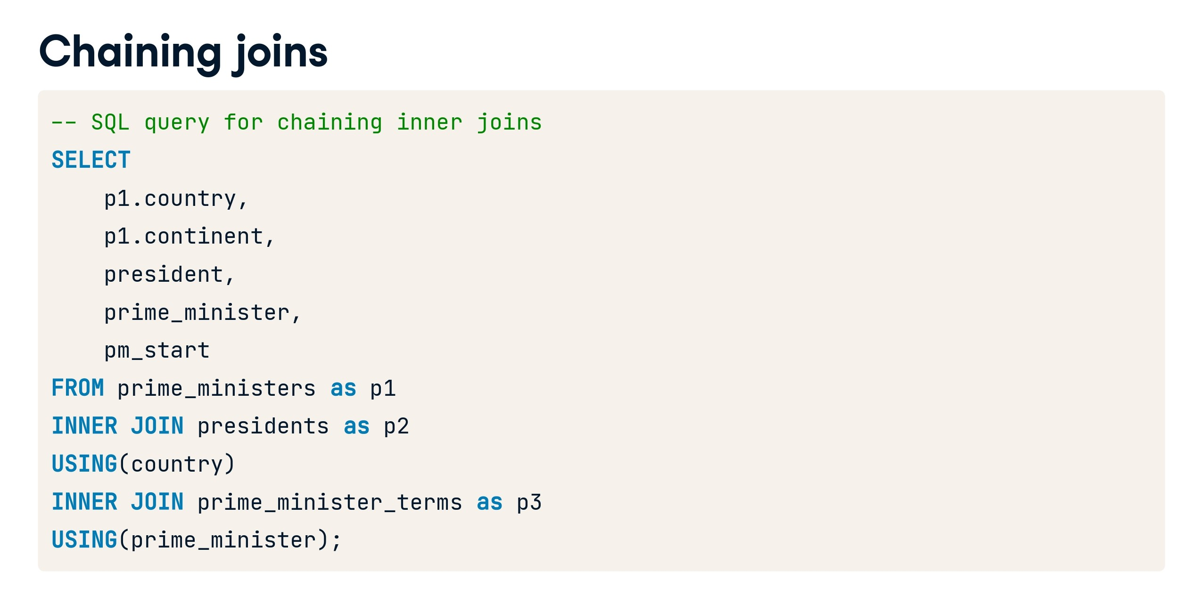

Slide 60
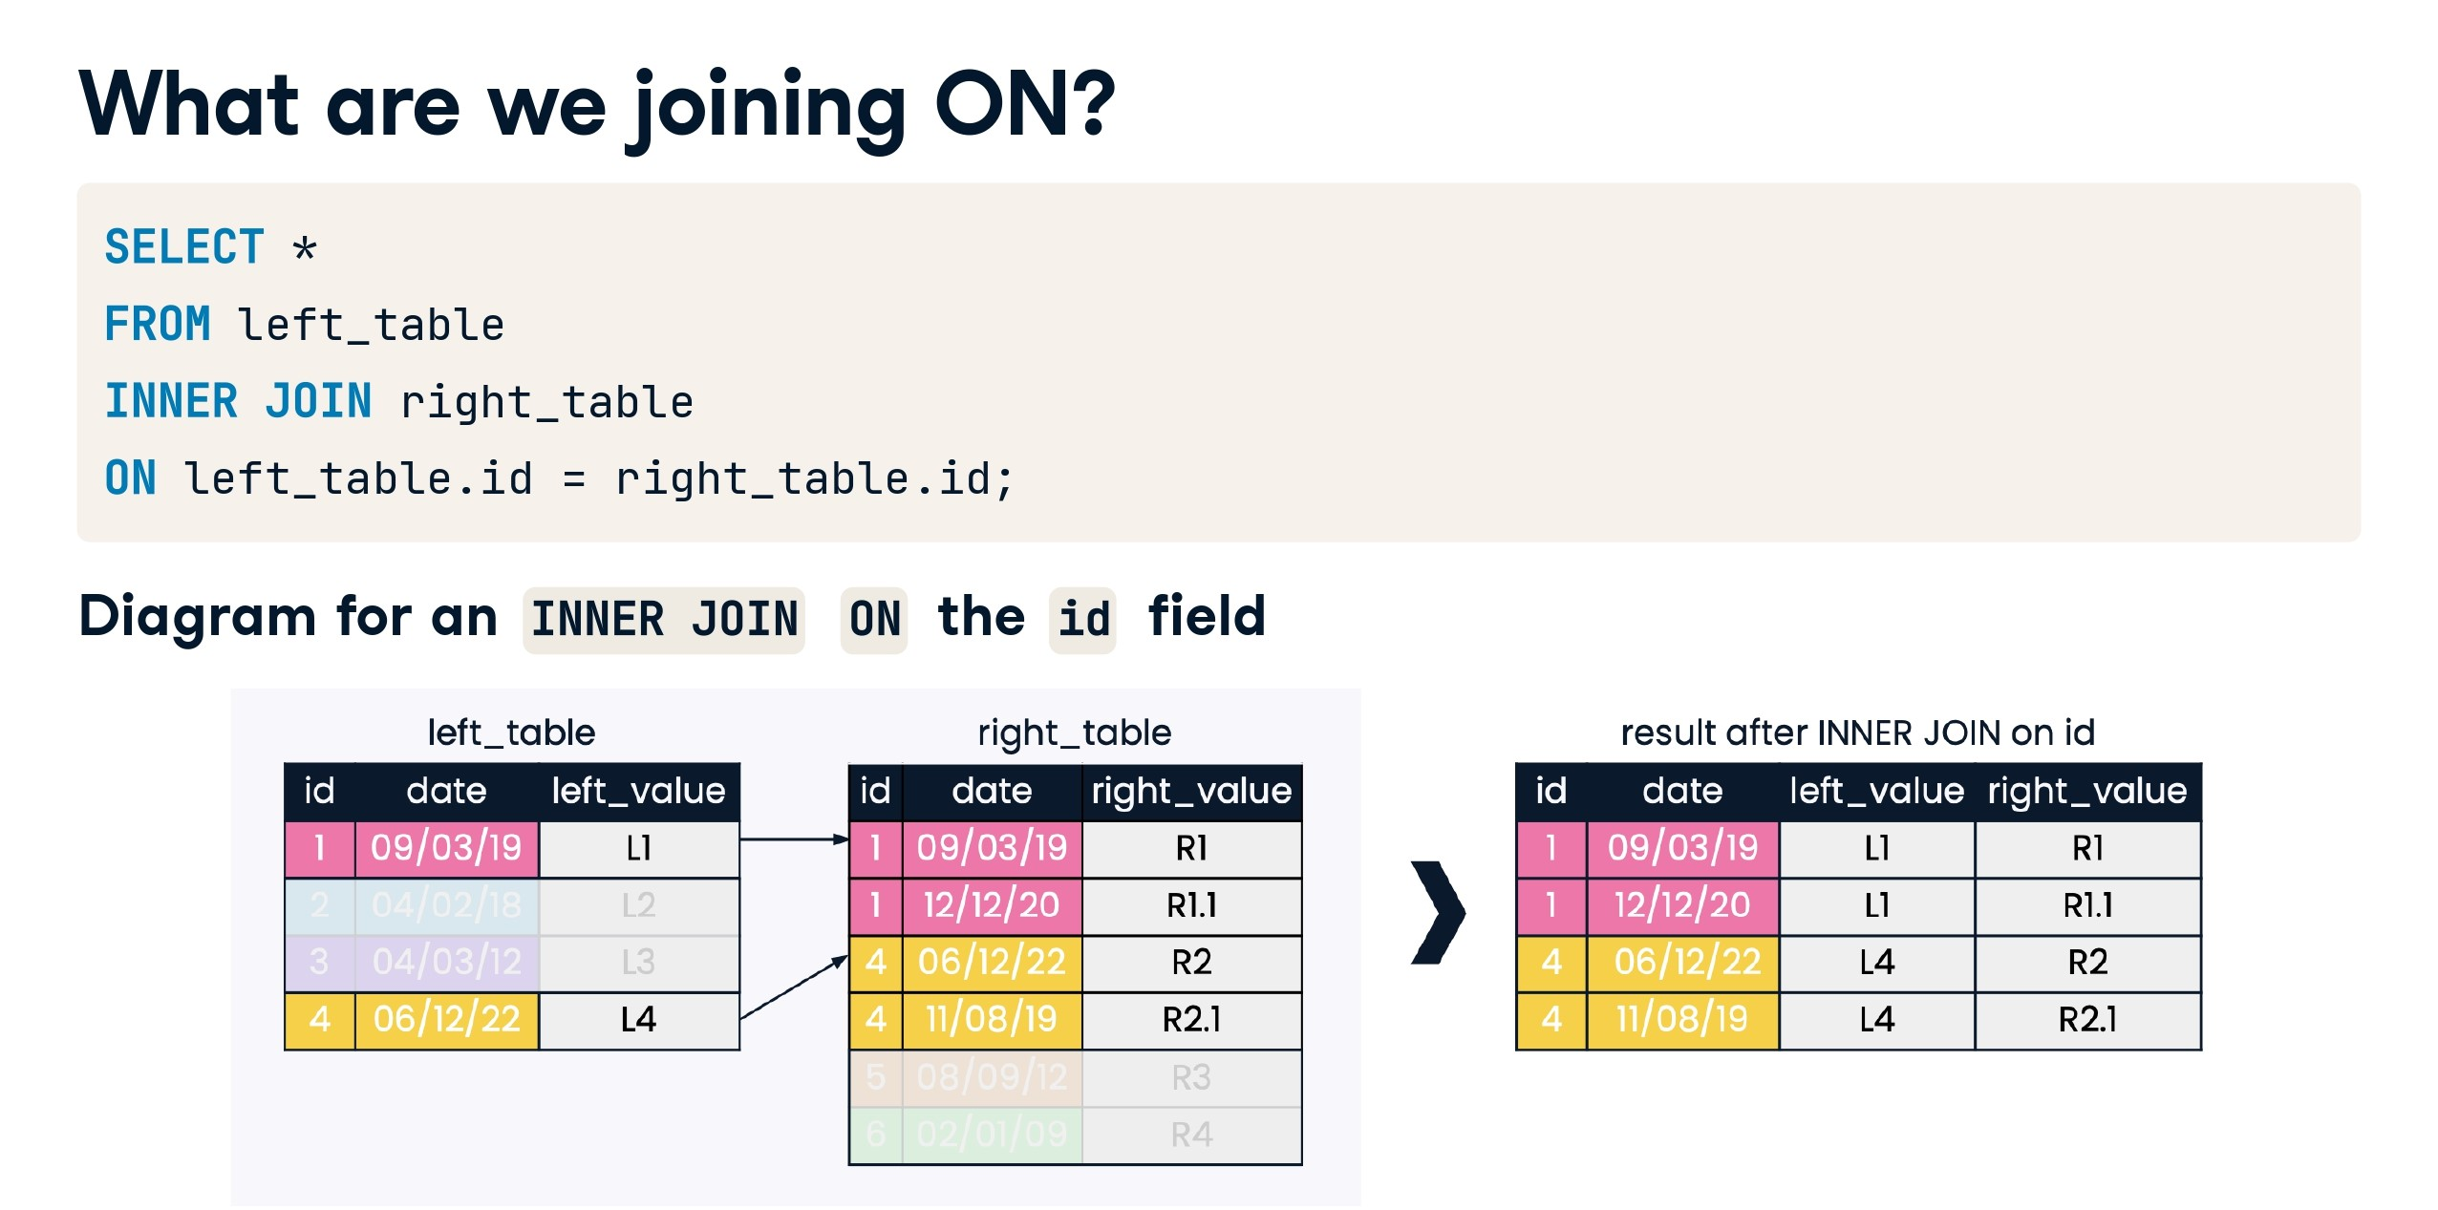

Slide 61
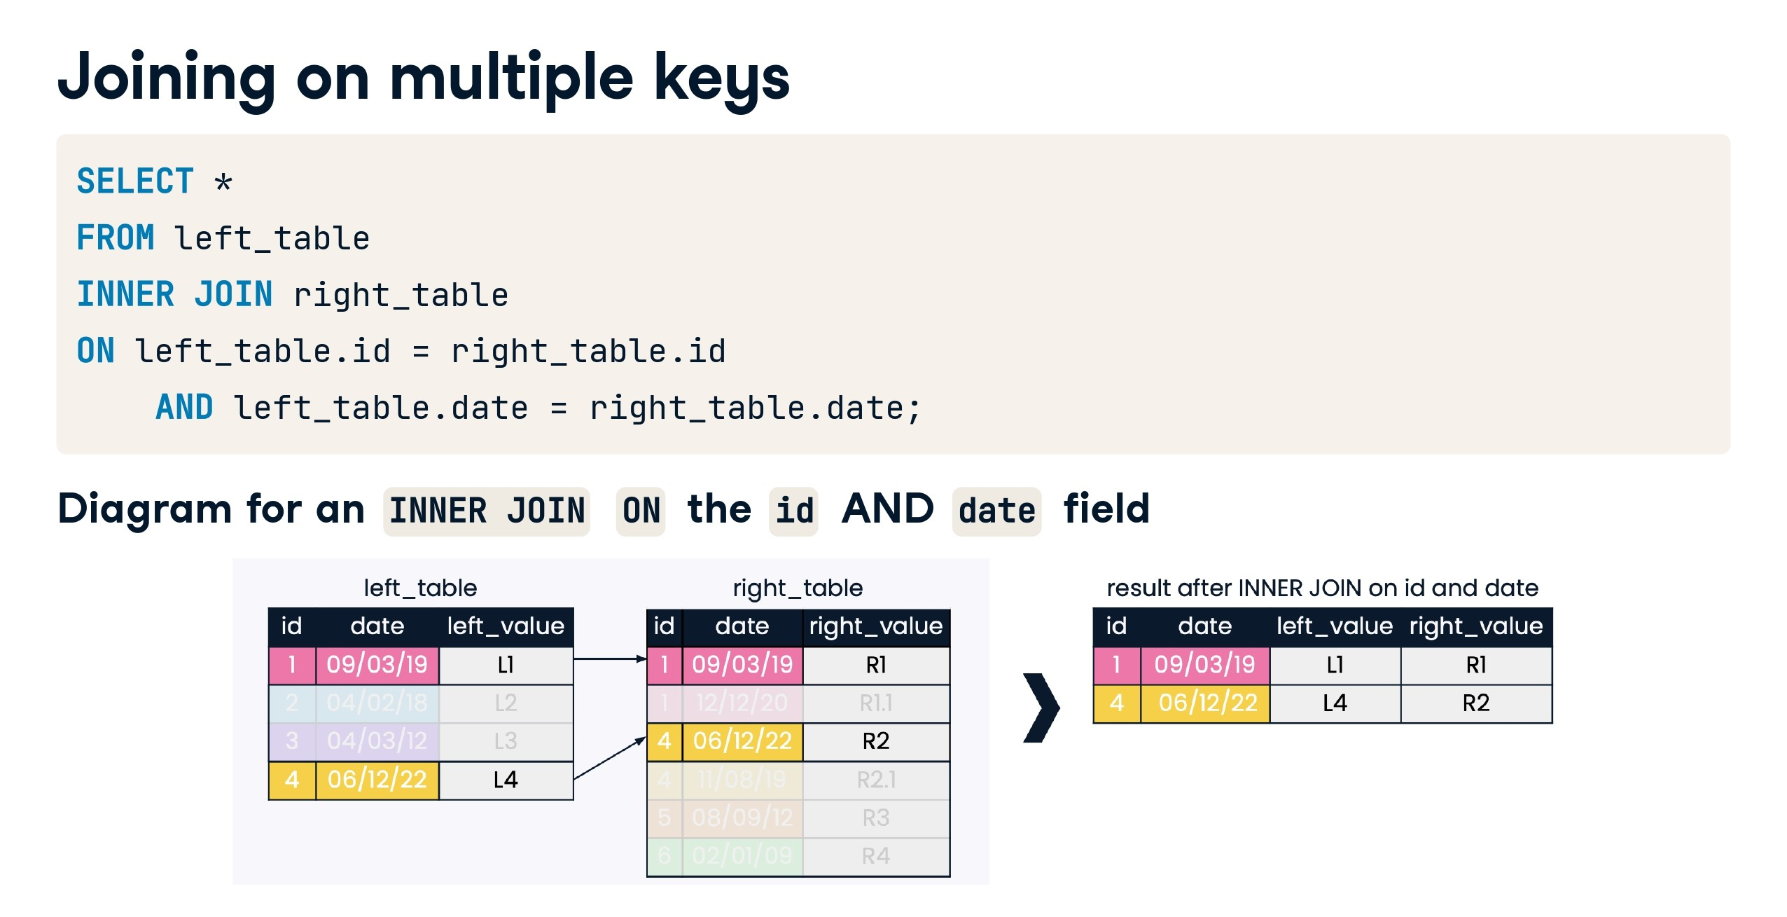

Slide 62
End of Day 3
Any Query?

